Slide 1

Chapter 12 Applications
12 Applications
Acknowledge to: Ke Li
Organizers: Guoqiang Zhong, Zhaoyang Niu
Machine Learning Research Group
Ocean University of China
Qingdao, China
https://github.com/AdolfKing/DeepLearningSlides

Slide 2

Chapter 12 Applications
12.1 Large Scale Deep Learning
12.2 Computer Vision
12.3 Speech Recognition
12.4 Natural Language Processing
12.5 Other Applications

Slide 3
12 Applications
In this chapter, we describe how to use deep learning to solve applications in computer vision, speech recognition, natural language processing, and other application areas of commercial interest. We begin by discussing the large scale neural network implementations required for most serious AI applications. Next, we review several specific application areas that deep learning has been used to solve. While one goal of deep learning is to design algorithms that are capable of solving a broad variety of tasks, so far some degree of specialization is needed. For example, vision tasks require processing a large number of input features (pixels) per example. Language tasks require modeling a large number of possible values (words in the vocabulary) per input feature.

Slide 4
Chapter 12 Applications
12.1 Large Scale Deep Learning
Acknowledge to: Ke Li
Organizers: Guoqiang Zhong, Zhaoyang Niu
Machine Learning Research Group
Ocean University of China
Qingdao, China
https://github.com/AdolfKing/DeepLearningSlides

Slide 5
12.1 Large Scale Deep Learning
Deep learning is based on the philosophy of connectionism: while an individual biological neuron or an individual feature in a machine learning model is not intelligent, a large population of these neurons or features acting together can exhibit intelligent behavior. It truly is important to emphasize the fact that the number of neurons must be large. One of the key factors responsible for the improvement in neural network’s accuracy and the improvement of the complexity of tasks they can solve between the 1980s and today is the dramatic increase in the size of the networks we use. As we saw in Sec. 1.2.3, network sizes have grown exponentially for the past three decades, yet artificial neural networks are only as large as the nervous systems of insects.
Because the size of neural networks is of paramount importance, deep learning requires high performance hardware and software infrastructure.

Slide 6
12.1.1 Fast CPU Implementations
Traditionally, neural networks were trained using the CPU of a single machine. Today, this approach is generally considered insufficient. We now mostly use GPU computing or the CPUs of many machines networked together. Before moving to these expensive setups, researchers worked hard to demonstrate that CPUs could not manage the high computational workload required by neural networks.
A description of how to implement efficient numerical CPU code is beyond the scope of this book, but we emphasize here that careful implementation for specific CPU families can yield large improvements. For example, in 2011, the best CPUs available could run neural network workloads faster when using fixed-point arithmetic rather than floating-point arithmetic.

Slide 7
12.1.1 Fast CPU Implementations
By creating a carefully tuned fixed-point implementation, Vanhoucke et al. (2011) obtained a 3× speedup over a strong floating-point system. Each new model of CPU has different performance characteristics, so sometimes floating-point implementations can be faster too. The important principle is that careful specialization of numerical computation routines can yield a large payoff. Other strategies, besides choosing whether to use fixed or floating point, include optimizing data structures to avoid cache misses and using vector instructions. Many machine learning researchers neglect these implementation details, but when the performance of an implementation restricts the size of the model, the accuracy of the model suffers.

Slide 8
12.1.2 GPU Implementations
Most modern neural network implementations are based on graphics processing units. Graphics processing units (GPUs) are specialized hardware components that were originally developed for graphics applications. The consumer market for video gaming systems spurred development of graphics processing hardware. The performance characteristics needed for good video gaming systems turn out to be beneficial for neural networks as well.
Video game rendering requires performing many operations in parallel quickly. Models of characters and environments are specified in terms of lists of 3-D coordinates of vertices. Graphics cards must perform matrix multiplication and division on many vertices in parallel to convert these 3-D coordinates into 2-D on-screen coordinates. The graphics card must then perform many computations at each pixel in parallel to determine the color of each pixel.

Slide 9
12.1.2 GPU Implementations
In both cases, the computations are fairly simple and do not involve much branching compared to the computational workload that a CPU usually encounters. For example, each vertex in the same rigid object will be multiplied by the same matrix; there is no need to evaluate an if statement per-vertex to determine which matrix to multiply by. The computations are also entirely independent of each other, and thus may be parallelized easily. The computations also involve processing massive buffers of memory, containing bitmaps describing the texture (color pattern) of each object to be rendered. Together, this results in graphics cards having been designed to have a high degree of parallelism and high memory bandwidth, at the cost of having a lower clock speed and less branching capability relative to traditional CPUs.
Neural network algorithms require the same performance characteristics as the real-time graphics algorithms described above.

Slide 10
12.1.2 GPU Implementations
Neural networks usually involve large and numerous buffers of parameters, activation values, and gradient values, each of which must be completely updated during every step of training. These buffers are large enough to fall outside the cache of a traditional desktop computer so the memory bandwidth of the system often becomes the rate limiting factor. GPUs offer a compelling advantage over CPUs due to their high memory bandwidth. Neural network training algorithms typically do not involve much branching or sophisticated control, so they are appropriate for GPU hardware. Since neural networks can be divided into multiple individual “neurons” that can be processed independently from the other neurons in the same layer, neural networks easily benefit from the parallelism of GPU computing.
GPU hardware was originally so specialized that it could only be used for graphics tasks.

Slide 11
12.1.2 GPU Implementations
Over time, GPU hardware became more flexible, allowing custom subroutines to be used to transform the coordinates of vertices or assign colors to pixels. In principle, there was no requirement that these pixel values actually be based on a rendering task. These GPUs could be used for scientific computing by writing the output of a computation to a buffer of pixel values. Steinkrau et al. (2005) implemented a two-layer fully connected neural network on a GPU and reported a 3X speedup over their CPU-based baseline. Shortly thereafter, Chellapilla et al. (2006) demonstrated that the same technique could be used to accelerate supervised convolutional networks.
The popularity of graphics cards for neural network training exploded after the advent of general purpose GPUs. These GP-GPUs could execute arbitrary code, not just rendering subroutines. NVIDIA’s CUDA programming language provided a way to write this arbitrary code in a C-like language.

Slide 12
12.1.2 GPU Implementations
With their relatively convenient programming model, massive parallelism, and high memory bandwidth, GP-GPUs now offer an ideal platform for neural network programming. This platform was rapidly adopted by deep learning researchers soon after it became available (Raina et al., 2009; Ciresan et al., 2010).
Writing efficient code for GP-GPUs remains a difficult task best left to spe- cialists. The techniques required to obtain good performance on GPU are very different from those used on CPU. For example, good CPU-based code is usually designed to read information from the cache as much as possible. On GPU, most writable memory locations are not cached, so it can actually be faster to compute the same value twice, rather than compute it once and read it back from memory. GPU code is also inherently multi-threaded and the different threads must be coordinated with each other carefully.

Slide 13
12.1.2 GPU Implementations
For example, memory operations are faster if they can be coalesced. Coalesced reads or writes occur when several threads can each read or write a value that they need simultaneously, as part of a single memory transaction. Different models of GPUs are able to coalesce different kinds of read or write patterns. Typically, memory operations are easier to coalesce if among n threads, thread i accesses byte i + j of memory, and j is a multiple of some power of 2. The exact specifications differ between models of GPU. Another common consideration for GPUs is making sure that each thread in a group executes the same instruction simultaneously. This means that branching can be difficult on GPU. Threads are divided into small groups called warps. Each thread in a warp executes the same instruction during each cycle, so if different threads within the same warp need to execute different code paths, these different code paths must be traversed sequentially rather than in parallel.

Slide 14
12.1.2 GPU Implementations
Due to the difficulty of writing high performance GPU code, researchers should structure their workflow to avoid needing to write new GPU code in order to test new models or algorithms. Typically, one can do this by building a software library of high performance operations like convolution and matrix multiplication, then specifying models in terms of calls to this library of operations. For example, the machine learning library Pylearn2 (Goodfellow et al., 2013c) specifies all of its machine learning algorithms in terms of calls to Theano (Bergstra et al., 2010; Bastien et al., 2012) and cuda-convnet (Krizhevsky, 2010), which provide these high-performance operations. This factored approach can also ease support for multiple kinds of hardware. For example, the same Theano program can run on either CPU or GPU, without needing to change any of the calls to Theano itself. Other libraries like TensorFlow (Abadi et al., 2015) and Torch (Collobert et al., 2011b) provide similar features.

Slide 15
12.1.3 Large Scale Distributed Implementations
In many cases, the computational resources available on a single machine are insufficient. We therefore want to distribute the workload of training and inference across many machines.
Distributing inference is simple, because each input example we want to process can be run by a separate machine. This is known as data parallelism.
It is also possible to get model parallelism, where multiple machines work together on a single datapoint, with each machine running a different part of the model. This is feasible for both inference and training.
Data parallelism during training is somewhat harder. We can increase the size of the minibatch used for a single SGD step, but usually we get less than linear returns in terms of optimization performance. It would be better to allow multiple machines to compute multiple gradient descent steps in parallel.

Slide 16
12.1.3 Large Scale Distributed Implementations
Unfortunately, the standard definition of gradient descent is as a completely sequential algorithm: the gradient at step t is a function of the parameters produced by step t − 1.
This can be solved using asynchronous stochastic gradient descent (Bengio et al., 2001; Recht et al., 2011). In this approach, several processor cores share the memory representing the parameters. Each core reads parameters without a lock, then computes a gradient, then increments the parameters without a lock. This reduces the average amount of improvement that each gradient descent step yields, because some of the cores overwrite each other’s progress, but the increased rate of production of steps causes the learning process to be faster overall. Dean et al. (2012) pioneered the multi-machine implementation of this lock-free approach to gradient descent, where the parameters are managed by a parameter server rather than stored in shared memory.

Slide 17
12.1.3 Large Scale Distributed Implementations
Distributed asynchronous gradient descent remains the primary strategy for training large deep networks and is used by most major deep learning groups in industry (Chilimbi et al., 2014; Wu et al., 2015). Academic deep learning researchers typically cannot afford the same scale of distributed learning systems but some research has focused on how to build distributed networks with relatively low-cost hardware available in the university setting (Coates et al., 2013).

Slide 18
12.1.4 Model Compression
In many commercial applications, it is much more important that the time and memory cost of running inference in a machine learning model be low than that the time and memory cost of training be low. For applications that do not require personalization, it is possible to train a model once, then deploy it to be used by billions of users. In many cases, the end user is more resource-constrained than the developer. For example, one might train a speech recognition network with a powerful computer cluster, then deploy it on mobile phones.
A key strategy for reducing the cost of inference is model compression (Bucilua et al., 2006). The basic idea of model compression is to replace the original, expensive model with a smaller model that requires less memory and runtime to store and evaluate.

Slide 19
12.1.4 Model Compression
Model compression is applicable when the size of the original model is driven primarily by a need to prevent overfitting. In most cases, the model with the lowest generalization error is an ensemble of several independently trained models. Evaluating all n ensemble members is expensive. Sometimes, even a single model generalizes better if it is large (for example, if it is regularized with dropout).
These large models learn some function f(x), but do so using many more parameters than are necessary for the task. Their size is necessary only due to the limited number of training examples. As soon as we have fit this function f(x), we can generate a training set containing infinitely many examples, simply by applying f to randomly sampled points x. We then train the new, smaller, model to match f(x) on these points.

Slide 20
12.1.4 Model Compression
In order to most efficiently use the capacity of the new, small model, it is best to sample the new x points from a distribution resembling the actual test inputs that will be supplied to the model later. This can be done by corrupting training examples or by drawing points from a generative model trained on the original training set.
Alternatively, one can train the smaller model only on the original training points, but train it to copy other features of the model, such as its posterior distribution over the incorrect classes (Hinton et al., 2014, 2015).

Slide 21
12.1.5 Dynamic Structure
One strategy for accelerating data processing systems in general is to build systems that have dynamic structure in the graph describing the computation needed to process an input. Data processing systems can dynamically determine which subset of many neural networks should be run on a given input. Individual neural networks can also exhibit dynamic structure internally by determining which subset of features (hidden units) to compute given information from the input. This form of dynamic structure inside neural networks is sometimes called conditional computation (Bengio, 2013; Bengio et al., 2013b). Since many components of the architecture may be relevant only for a small amount of possible inputs, the system can run faster by computing these features only when they are needed.
Dynamic structure of computations is a basic computer science principle applied generally throughout the software engineering discipline.

Slide 22
12.1.5 Dynamic Structure
The simplest versions of dynamic structure applied to neural networks are based on determining which subset of some group of neural networks (or other machine learning models) should be applied to a particular input.
A venerable strategy for accelerating inference in a classifier is to use a cascade of classifiers. The cascade strategy may be applied when the goal is to detect the presence of a rare object (or event). To know for sure that the object is present, we must use a sophisticated classifier with high capacity, that is expensive to run. However, because the object is rare, we can usually use much less computation to reject inputs as not containing the object. In these situations, we can train a sequence of classifiers. The first classifiers in the sequence have low capacity, and are trained to have high recall. In other words, they are trained to make sure we do not wrongly reject an input when the object is present.

Slide 23
12.1.5 Dynamic Structure
The final classifier is trained to have high precision. At test time, we run inference by running the classifiers in a sequence, abandoning any example as soon as any one element in the cascade rejects it. Overall, this allows us to verify the presence of objects with high confidence, using a high capacity model, but does not force us to pay the cost of full inference for every example. There are two different ways that the cascade can achieve high capacity. One way is to make the later members of the cascade individually have high capacity. In this case, the system as a whole obviously has high capacity, because some of its individual members do. It is also possible to make a cascade in which every individual model has low capacity but the system as a whole has high capacity due to the combination of many small models. Viola and Jones (2001) used a cascade of boosted decision trees to implement a fast and robust face detector suitable for use in handheld digital cameras.

Slide 24
12.1.5 Dynamic Structure
Their classifier localizes a face using essentially a sliding window approach in which many windows are examined and rejected if they do not contain faces. Another version of cascades uses the earlier models to implement a sort of hard attention mechanism: the early members of the cascade localize an object and later members of the cascade perform further processing given the location of the object. For example, Google transcribes address numbers from Street View imagery using a two-step cascade that first locates the address number with one machine learning model and then transcribes it with another (Goodfellow et al., 2014d).
Decision trees themselves are an example of dynamic structure, because each node in the tree determines which of its subtrees should be evaluated for each input.

Slide 25
12.1.5 Dynamic Structure
A simple way to accomplish the union of deep learning and dynamic structure is to train a decision tree in which each node uses a neural network to make thesplitting decision (Guo and Gelfand, 1992), though this has typically not been done with the primary goal of accelerating inference computations.
In the same spirit, one can use a neural network, called the gater to select which one out of several expert networks will be used to compute the output, given the current input. The first version of this idea is called the mixture of experts (Nowlan, 1990; Jacobs et al., 1991), in which the gater outputs a set of probabilities or weights (obtained via a softmax nonlinearity), one per expert, and the final output is obtained by the weighted combination of the output of the experts.

Slide 26
12.1.5 Dynamic Structure
In that case, the use of the gater does not offer a reduction in computational cost, but if a single expert is chosen by the gater for each example, we obtain the hard mixture of experts (Collobert et al., 2001, 2002), which can considerably accelerate training and inference time. This strategy works well when the number of gating decisions is small because it is not combinatorial. But when we want to select different subsets of units or parameters, it is not possible to use a “soft switch” because it requires enumerating (and computing outputs for) all the gater configurations. To deal with this problem, several approaches have been explored to train combinatorial gaters.

Slide 27
12.1.5 Dynamic Structure
Bengio et al. (2013b) experiment with several estimators of the gradient on the gating probabilities, while Bacon et al. (2015) and Bengio et al. (2015a) use reinforcement learning techniques (policy gradient) to learn a form of conditional dropout on blocks of hidden units and get an actual reduction in computational cost without impacting negatively on the quality of the approximation.
Another kind of dynamic structure is a switch, where a hidden unit can receive input from different units depending on the context. This dynamic routing approach can be interpreted as an attention mechanism (Olshausen et al., 1993).So far, the use of a hard switch has not proven effective on large-scale applications.

Slide 28
12.1.5 Dynamic Structure
Contemporary approaches instead use a weighted average over many possible inputs, and thus do not achieve all of the possible computational benefits of dynamic structure. Contemporary attention mechanisms are described in Sec. 12.4.5.1.
One major obstacle to using dynamically structured systems is the decreased degree of parallelism that results from the system following different code branches for different inputs. This means that few operations in the network can be described as matrix multiplication or batch convolution on a minibatch of examples. We can write more specialized sub-routines that convolve each example with different kernels or multiply each row of a design matrix by a different set of columns of weights.

Slide 29
12.1.5 Dynamic Structure
Unfortunately, these more specialized subroutines are difficult to implement efficiently. CPU implementations will be slow due to the lack of cache coherence and GPU implementations will be slow due to the lack of coalesced memory transactions and the need to serialize warps when members of a warp take different branches. In some cases, these issues can be mitigated by partitioning the examples into groups that all take the same branch, and processing these groups of examples simultaneously. This can be an acceptable strategy for minimizing the time required to process a fixed amount of examples in an offline setting. In a real-time setting where examples must be processed continuously, partitioning the workload can result in load-balancing issues.

Slide 30
12.1.5 Dynamic Structure
For example, if we assign one machine to process the first step in a cascade and another machine to process the last step in a cascade, then the first will tend to be overloaded and the last will tend to be underloaded. Similar issues arise if each machine is assigned to implement different nodes of a neural decision tree.

Slide 31
12.1.6 Specialized Hardware Implementations of Deep Networks
Since the early days of neural networks research, hardware designers have worked on specialized hardware implementations that could speed up training and/or inference of neural network algorithms. See early and more recent reviews of specialized hardware for deep networks (Lindsey and Lindblad, 1994; Beiu et al., 2003; Misra and Saha, 2010).
Different forms of specialized hardware (Graf and Jackel, 1989; Mead and Ismail, 2012; Kim et al., 2009; Pham et al., 2012; Chen et al., 2014a,b) have been developed over the last decades, either with ASICs (application-specific integrated circuit), either with digital (based on binary representations of numbers), analog (Graf and Jackel, 1989; Mead and Ismail, 2012) (based on physical implementations of continuous values as voltages or currents) or hybrid implementations (combining digital and analog components).

Slide 32
12.1.6 Specialized Hardware Implementations of Deep Networks
In recent years more flexible FPGA (field programmable gated array) implementations (where the particulars of the circuit can be written on the chip after it has been built) have been developed.
Though software implementations on general-purpose processing units (CPUs and GPUs) typically use 32 or 64 bits of precision to represent floating point numbers, it has long been known that it was possible to use less precision, at least at inference time (Holt and Baker, 1991; Holi and Hwang, 1993; Presley and Haggard, 1994; Simard and Graf, 1994; Wawrzynek et al., 1996; Savich et al., 2007). This has become a more pressing issue in recent years as deep learning has gained in popularity in industrial products, and as the great impact of faster hardware was demonstrated with GPUs.

Slide 33
12.1.6 Specialized Hardware Implementations of Deep Networks
Another factor that motivates current research on specialized hardware for deep networks is that the rate of progress of a single CPU or GPU core has slowed down, and most recent improvements in computing speed have come from parallelization across cores (either in CPUs or GPUs). This is very different from the situation of the 1990s (the previous neural network era) where the hardware implementations of neural networks (which might take two years from inception to availability of a chip) could not keep up with the rapid progress and low prices of general-purpose CPUs.

Slide 34
12.1.6 Specialized Hardware Implementations of Deep Networks
Building specialized hardware is thus a way to push the envelope further, at a time when new hardware designs are being developed for low-power devices such as phones, aiming for general-public applications of deep learning (e.g., with speech, computer vision or natural language).
Recent work on low-precision implementations of backprop-based neural nets (Vanhoucke et al., 2011; Courbariaux et al., 2015; Gupta et al., 2015) suggests that between 8 and 16 bits of precision can suffice for using or training deep neural networks with back-propagation. What is clear is that more precision is required during training than at inference time, and that some forms of dynamic fixed point representation of numbers can be used to reduce how many bits are required per number.

Slide 35
12.1.6 Specialized Hardware Implementations of Deep Networks
Traditional fixed point numbers are restricted to a fixed range (which corresponds to a given exponent in a floating point representation). Dynamic fixed point representations share that range among a set of numbers (such as all the weights in one layer). Using fixed point rather than floating point representations and using less bits per number reduces the hardware surface area, power requirements and computing time needed for performing multiplications, and multiplications are the most demanding of the operations needed to use or train a modern deep network with backprop.

Slide 36
Chapter 12 Applications
12.2 Computer Vision
Acknowledge to: Wanying Chen
Organizers: Guoqiang Zhong, Zhaoyang Niu
Machine Learning Research Group
Ocean University of China
Qingdao, China
https://github.com/AdolfKing/DeepLearningSlides

Slide 37
12.2 Computer Vision
Computer vision has traditionally been one of the most active research areas for deep learning applications, because vision is a task that is effortless for humans and many animals but challenging for computers (Ballard et al., 1983). Many of the most popular standard benchmark tasks for deep learning algorithms are forms of object recognition or optical character recognition.
Computer vision is a very broad field encompassing a wide variety of ways of processing images, and an amazing diversity of applications. Applications of computer vision range from reproducing human visual abilities, such as recognizing faces, to creating entirely new categories of visual abilities.

Slide 38
12.2 Computer Vision
As an example of the latter category, one recent computer vision application is to recognize sound waves from the vibrations they induce in objects visible in a video (Davis et al., 2014).Most deep learning research on computer vision has not focused on such exotic applications that expand the realm of what is possible with imagery but rather a small core of AI goals aimed at replicating human abilities. Most deep learning for computer vision is used for object recognition or detection of some form, whether this means reporting which object is present in an image, annotating an image with bounding boxes around each object, transcribing a sequence of symbols from an image, or labeling each pixel in an image with the identity of the object it belongs to.

Slide 39
12.2 Computer Vision
Because generative modeling has been a guiding principle of deep learning research, there is also a large body of work on image synthesis using deep models. While image synthesis ex nihilo is usually not considered a computer vision endeavor, models capable of image synthesis are usually useful for image restoration, a computer vision task involving repairing defects in images or removing objects from images.

Slide 40
12.2.1 Preprocessing
Many application areas require sophisticated preprocessing because the original input comes in a form that is difficult for many deep learning architectures to represent. Computer vision usually requires relatively little of this kind of prepro-cessing. The images should be standardized so that their pixels all lie in the same, reasonable range, like [0,1] or [-1,1]. Mixing images that lie in [0,1] with images that lie in [0, 255] will usually result in failure. Formatting images to have the same scale is the only kind of preprocessing that is strictly necessary.Many compute vision architectures require images of a standard size, so images must be cropped or scaled to fit that size.

Slide 41
12.2.1 Preprocessing
However, even this rescaling is not always strictly necessary. Some convolutional models accept variably-sized inputs and dynamically adjust the size of their pooling regions to keep the output size constant (Waibel et al.,1989). Other convolutional models have variable-sized output that automatically scales in size with the input, such as models that denoise or label each pixel in an image (Hadsell et al., 2007).
Other kinds of preprocessing are applied to both the train and the test set with the goal of putting each example into a more canonical form in order to reduce the amount of variation that the model needs to account for. Reducing the amount of variation in the data can both reduce generalization error and reduce the size of the model needed to fit the training set.

Slide 42
12.2.1 Preprocessing
Simpler tasks may be solved by smaller models, and simpler solutions are more likely to generalize well. Preprocessing of this kind is usually designed to remove some kind of variability in the input data that is easy for a human designer to describe and that the human designer is confident has no relevance to the task. When training with large datasets and large models, this kind of preprocessing is often unnecessary, and it is best to just let the model learn which kinds of variability it should become invariant to. For example, the AlexNet system for classifying ImageNet only has one preprocessing step: subtracting the mean across training examples of each pixel (Krizhevsky et al., 2012)

Slide 43
12.2.1.1 Contrast Normalization
One of the most obvious sources of variation that can be safely removed for many tasks is the amount of contrast in the image. Contrast simply refers to themagnitude of the difference between the bright and the dark pixels in an image. There are many ways of quantifying the contrast of an image. In the context of deep learning, contrast usually refers to the standard deviation of the pixels in an image or region of an image. Suppose we have an image represented by a tensor X ∈ R^{r×c×3}, with X_{i,j,1} being the red intensity at row i and column j, X_{i,j,2} giving the green intensity and X_{i,j,3} giving the blue intensity.

Slide 44
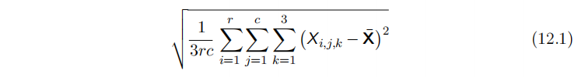
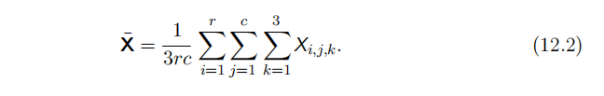
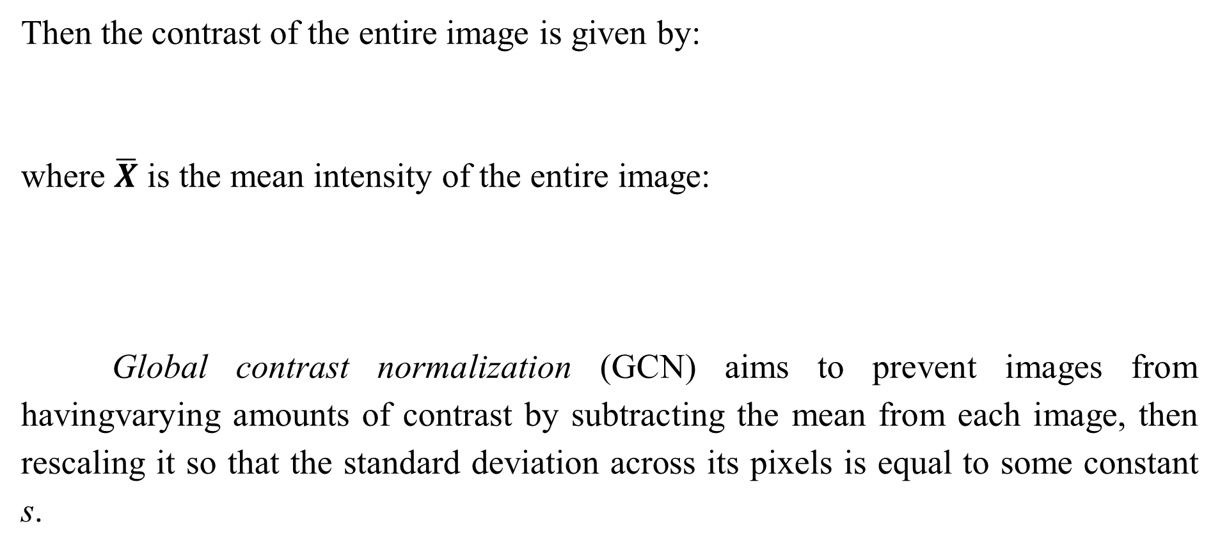
12.2.1.1 Contrast Normalization
Then the contrast of the entire image is given by:
where $\overline{X}$ is the mean intensity of the entire image:
Global contrast normalization (GCN) aims to prevent images from havingvarying amounts of contrast by subtracting the mean from each image, then rescaling it so that the standard deviation across its pixels is equal to some constant s.

Slide 45
12.2.1.1 Contrast Normalization
This approach is complicated by the fact that no scaling factor canchange the contrast of a zero-contrast image (one whose pixels all have equal intensity). Images with very low but non-zero contrast often have little informationcontent. Dividing by the true standard deviation usually accomplishes nothing more than amplifying sensor noise or compression artifacts in such cases. Thismotivates introducing a small, positive regularization parameter λ to bias theestimate of the standard deviation. Alternately, one can constrain the denominator to be at least s.

Slide 46
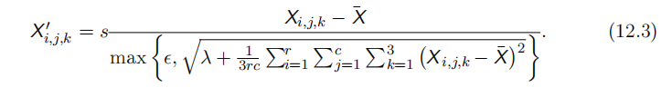
12.2.1.1 Contrast Normalization
Given an input image ,GCN produce an output image X',defined such that:
Datasets consisting of large images cropped to interesting objects are unlikely to contain any images with nearly constant intensity. In these cases, it is safe to practically ignore the small denominator problem by setting λ = 0 and avoid division by 0 in extremely rare cases by setting s to an extremely low value like10⁻⁸. This is the approach used by Goodfellow et al. (2013a) on the CIFAR-10 dataset.

Slide 47
12.2.1.1 Contrast Normalization
Small images cropped randomly are more likely to have nearly constantintensity, making aggressive regularization more useful. Coates et al. (2011) used s = 0 and λ = 10 on small, randomly selected patches drawn from CIFAR-10.The scale parameter s can usually be set to 1, as done by Coates et al. (2011),or chosen to make each individual pixel have standard deviation across examples close to 1, as done by Goodfellow et al. (2013a).
The standard deviation in Eq. 12.3 is just a rescaling of the L² norm of theimage (assuming the mean of the image has already been removed).

Slide 48
12.2.1.1 Contrast Normalization
It is preferable to define GCN in terms of standard deviation rather than L² norm because the standard deviation includes division by the number of pixels, so GCN based onstandard deviation allows the same s to be used regardless of image size. However,the observation that the L² norm is proportional to the standard deviation canhelp build a useful intuition. One can understand GCN as mapping examples to a spherical shell. See Fig. 12.1 for an illustration. This can be a useful propertybecause neural networks are often better at responding to directions in space ratherthan exact locations. Responding to multiple distances in the same directionrequires hidden units with collinear weight vectors but different biases.

Slide 49
12.2.1.1 Contrast Normalization
Such coordination can be difficult for the learning algorithm to discover. Additionally,many shallow graphical models have problems with representing multiple separatedmodes along the same line. GCN avoids these problems by reducing each example to a direction rather than a direction and a distance.
Counterintuitively, there is a preprocessing operation known as sphering and it is not the same operation as GCN. Sphering does not refer to making the data lie on a spherical shell, but rather to rescaling the principal components to have equal variance, so that the multivariate normal distribution used by PCA has spherical contours. Sphering is more commonly known as whitening.

Slide 50
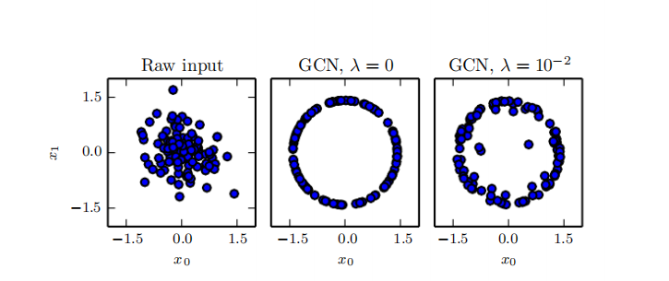
12.2.1.1 Contrast Normalization
Figure 12.1: GCN maps examples onto a sphere. (Left) Raw input data may have anynorm. (Center) GCN with with λ = 0 maps all non-zero examples perfectly onto a sphere.Here we use s = 1 and s = 10−8 . Because we use GCN based on normalizing the standard deviation rather than the L² norm, the resulting sphere is not the unit sphere. (Right) Regularized GCN, with λ > 0, draws examples toward the sphere but does not completelydiscard the variation in their norm. We leave s and s the same as before.

Slide 51
12.2.1.1 Contrast Normalization
Global contrast normalization will often fail to highlight image features wewould like to stand out, such as edges and corners. If we have a scene with a standard dark area and a large bright area (such as a city square with half the image inthe shadow of a building) then global contrast normalization will ensure there is a large difference between the brightness of the dark area and the brightness of thelight area. It will not, however, ensure that edges within the dark region stand out.
This motivates local contrast normalization. Local contrast normalization ensures that the contrast is normalized across each comparison of global and local contrast normalization.

Slide 52
12.2.1.1 Contrast Normalization
Various definitions of local contrast normalization are possible. In all cases, one modifies each pixel by subtracting a mean of nearby pixels and dividing bya standard deviation of nearby pixels. In some cases, this is literally the meanand standard deviation of all pixels in a rectangular window centered on thepixel to be modified (Pinto et al., 2008). In other cases, this is a weighted mean and weighted standard deviation using Gaussian weights centered on the pixel to be modified. In the case of color images, some strategies comparison process different color channels separately while others combine information from different channels tonormalize each pixel (Sermanet et al., 2012).

Slide 53
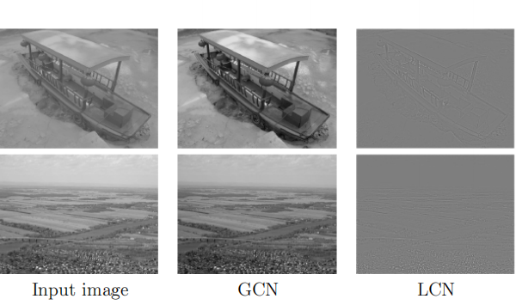
12.2.1.1 Contrast Normalization
Figure 12.2: A comparison of global and local contrast normalization. Visually, the effects of global contrast normalization are subtle. It places all images on roughly the same scale, which reduces the burden on the learning algorithm to handle multiple scales. Local contrast normalization modifies the image much more, discarding all regions of constant intensity. This allows the model to focus on just the edges. Regions of fine texture,such as the houses in the second row, may lose some detail due to the bandwidth of the normalization kernel being too high.

Slide 54
12.2.1.1 Contrast Normalization
Local contrast normalization can usually be implemented efficiently by using separable convolution (see Sec. 9.8) to compute feature maps of local means and local standard deviations, then using element-wise subtraction and element-wise division on different feature maps.
Local contrast normalization is a differentiable operation and can also be used as a nonlinearity applied to the hidden layers of a network, as well as a preprocessing operation applied to the input.
As with global contrast normalization, we typically need to regularize local contrast normalization to avoid division by zero. In fact, because local contrast normalization typically acts on smaller it is even more important to regularize.

Slide 55
12.2.1.1 Contrast Normalization
Smaller windows are more likely to contain values that are all nearly the same as each other, and thus more likely to have zero standard deviation.

Slide 56
12.2.1.2 Dataset Augmentation
As described in Sec. 7.4, it is easy to improve the generalization of a classifier by increasing the size of the training set by adding extra copies of the training examples that have been modified with transformations that do not change theclass. Object recognition is a classification task that is especially amenable to this form of dataset augmentation because the class is invariant to so many transformations and the input can be easily transformed with many geometric operations. As described before, classifiers can benefit from random translations, rotations, and in some cases, flips of the input to augment the dataset. In specialized computer vision applications, more advanced transformations are commonly used for dataset augmentation. These schemes include random perturbation of the colors in an image (Krizhevsky et al., 2012) and nonlinear geometric distortions of the input (LeCun et al., 1998b).

Slide 57
Chapter 12 Applications
12.3 Speech Recognition
Acknowledge to: Wanying Chen
Organizers: Guoqiang Zhong, Zhaoyang Niu
Machine Learning Research Group
Ocean University of China
Qingdao, China
https://github.com/AdolfKing/DeepLearningSlides

Slide 58
12.3 Speech Recognition
The task of speech recognition is to map an acoustic signal containing a spoken natural language utterance into the corresponding sequence of words intended by the speaker. Let X = (x⁽¹⁾ , x⁽²⁾ , . . . , x^{(T)}) denote the sequence of acoustic input vectors (traditionally produced by splitting the audio into 20ms frames). Most speech recognition systems preprocess the input using specialized hand-designed features, but some (Jaitly and Hinton, 2011) deep learning systems learn featuresfrom raw input. Let y = (y₁, y₂, . . . , y_{N} ) denote the target output sequence(usually a sequence of words or characters).

Slide 59
12.3 Speech Recognition
The automatic speech recognition(ASR) taskconsists of creating a function f*_{ASR} that computes the most probable linguistic sequence y given the acoustic sequence X:
where P* is the true conditional distribution relating the inputs X to the targets y.
Since the 1980s and until about 2009–2012, state-of-the art speech recognitionsystems primarily combined hidden Markov models (HMMs) and Gaussian mixturemodels (GMMs). GMMs modeled the association between acoustic features and phonemes (Bahl et al.,1987),while HMMs modeled the sequence of phonemes.

Slide 60
12.3 Speech Recognition
The GMM-HMM model family treats acoustic waveforms as being generated by the following process: first an HMM generates a sequence of phonemes and discrete sub-phonemic states (such as the beginning, middle, and end of each phoneme), then a GMM transforms each discrete symbol into a brief segment of audio waveform. Although GMM-HMM systems dominated ASR until recently,speech recognition was actually one of the first areas where neural networks were applied, and numerous ASR systems from the late 1980s and early 1990s used neural nets (Bourlard and Wellekens, 1989; Waibel et al.,1989; Robinson and Fallside, 1991; Bengio et al., 1991, 1992; Konig et al., 1996).

Slide 61
12.3 Speech Recognition
At the time, theperformance of ASR based on neural nets approximately matched the performanceof GMM-HMM systems. For example, Robinson and Fallside (1991) achieved 26% phoneme error rate on the TIMIT (Garofolo et al., 1993) corpus (with 39 phonemes to discriminate between), which was better than or comparable toHMM-based systems. Since then, TIMIT has been a benchmark for phoneme recognition, playing a role similar to the role MNIST plays for object recognition.

Slide 62
12.3 Speech Recognition
However, because of the complex engineering involved in software systems for speech recognition and the effort that had been invested in building these systems on the basis of GMM-HMMs, the industry did not see a compelling argument for switching to neural networks. As a consequence, until the late 2000s, both academic and industrial research in using neural nets for speech recognition mostly focused on using neural nets to learn extra features for GMM-HMM systems.
Later, with much larger and deeper models and much larger datasets,recognition accuracy was dramatically improved by using neural networks toreplace GMMs for the task of associating acoustic features to phonemes (or subphonemic states), Starting in 2009, speech researchers applied a form of deep learning based on unsupervised learning to speech recognition.

Slide 63
12.3 Speech Recognition
This approach to deep learning was based on training undirected probabilistic models called restricted Boltzmann machines (RBMs) to model the input data. RBMs will bedescribed in Part III. To solve speech recognition tasks, unsupervised pretraining was used to build deep feedforward networks whose layers were each initialized by training an RBM. These networks take spectral acoustic representations in a fixed-size input window (around a center frame) and predict the conditional probabilities of HMM states for that center frame.

Slide 64
12.3 Speech Recognition
Training such deep networks helped to significantly improve the recognition rate on TIMIT (Mohamed et al.,2009, 2012a), bringing down the phoneme error rate from about 26% to 20.7%. See Mohamed et al. (2012b) for an analysis of reasons for the success of these models. Extensions to the basic phone recognition pipeline included the addition of speaker-adaptive features (Mohamed et al., 2011) that further reduced the error rate. This was quickly followed up by work to expand the architecture from phoneme recognition (which is what TIMIT is focused on) to large-vocabulary speech recognition(Dahl et al., 2012), which involves not just recognizing phonemes but also recognizing sequences of words from a large vocabulary.

Slide 65
12.3 Speech Recognition
Deep networks for speech recognition eventually shifted from being based on pretraining and Boltzmann machines to being based on techniques such as rectified linear units and dropout (Zeiler et al., 2013; Dahl et al., 2013). By that time,several of the major speech groups in industry had started exploring deep learning in collaboration withacademic researchers. Hinton et al. (2012a) describe the breakthroughs achievedby these collaborators, which are now deployed in such as mobile phones.

Slide 66
12.3 Speech Recognition
Later, as these groups explored larger and larger labeled datasets and incorporated some of the methods for initializing, training, and setting up the architecture of deep nets, they realized that the unsupervised pretraining phase was either unnecessary or did not bring any significant improvement.
These breakthroughs in recognition performance for word error rate in speechrecognition were recognition were unprecedented (around 30% improvement) and and were following a long period of about ten years during which error rates did not improve much with the traditional GMM-HMM technology, in spite of the continuously growing size of training sets (see Fig. 2.4 of Deng and Yu (2014)).

Slide 67
12.3 Speech Recognition
This created a rapid shift in the speech recognition community towards deep learning. In a matter of roughly two years, most of the industrial products for speech recognition incorporated deep neural networks and this success spurred a new wave of research into deep learningalgorithms and architectures for ASR, which is still ongoing today.
One of these innovations was the use of convolutional networks (Sainath et al., 2013) that replicate weights across time and frequency, improving over the earlier time-delay neural networks that replicated weights only across time. The new two-dimensional convolutional models regard the input spectrogram not as one long vector but as an image, with one axis corresponding to time and the other to frequency of spectral components.

Slide 68
12.3 Speech Recognition
Another important push, still ongoing, has been towards end-to-end deep learning speech recognition systems that completely remove the HMM. The first major breakthrough in this direction came from Graves et al. (2013) who trained a deep LSTM RNN(see Sec. 10.10),using MAP inference over the frame-to-phoneme, as in LeCun et al. (1998b) and in the CTC framework (Graves et al., 2006; Graves, 2012). A deep RNN (Graves et al., 2013) has state variables from several layers at each time step, giving the unfolded graph two kinds of depth: ordinary depth due to a stack of layers, and depth due to time unfolding. This work brought the phoneme error rate on TIMIT to a record low of 17.7%. See Pascanu et al. (2014a) and Chung et al. (2014) for other variants of deep RNNs, applied in other settings.

Slide 69
12.3 Speech Recognition
Another contemporary step toward end-to-end deep learning ASR is to let the system learn how to “align” the acoustic-level information with the phonetic-level information (Chorowski et al., 2014; Lu et al., 2015).

Slide 70
Chapter 12 Applications
12.4 Natural Language Processing
Acknowledge to: Wanying Chen, Liande Bi
Organizers: Guoqiang Zhong, Zhaoyang Niu
Machine Learning Research Group
Ocean University of China
Qingdao, China
https://github.com/AdolfKing/DeepLearningSlides

Slide 71
12.4 Natural Language Processing
Natural language processing (NLP) is the use of human languages, such as English or French, by a computer. Computer programs typically read and emit specialized languages designed to allow efficient and unambiguous parsing by simple programs. More naturally occurring languages are often ambiguous and defy formal description. Natural language processing includes applications such as machine translation,in which the learner must read a sentence in one human language and emit anequivalent sentence in another human language. Many NLP applications are based on language models that define a probability distribution over sequences of words, characters or bytes in a natural language.

Slide 72
12.4 Natural Language Processing
As with the other applications discussed in this chapter, very generic neural network techniques can be successfully applied to natural language processing.However, to achieve excellent performance and to scale well to large applications,some domain-specific strategies become important. To build an efficient model of natural language, we must usually use techniques that are specialized for processing sequential data. In many cases, we choose to regard natural language as a sequence of words, rather than a sequence of individual characters or bytes.

Slide 73
12.4 Natural Language Processing
Because the total number of possible words is so large, word-based language models must operate on an extremely high-dimensional and sparse discrete space. Several strategies have been developed to make models of such a space efficient, both in a computational and in a statistical sense.

Slide 74

12.4.1 n-grams
A language model defines a probability distribution over sequences of tokens in a natural language. Depending on how the model is designed, a token may be a word, a character, or even a byte. Tokens are always discrete entities. The earliest successful language models were based on models of fixed-length sequences of tokens called n-grams. An n-gram is a sequence of n tokens.
Models based on n-grams define the conditional probability of the n-th tokengiven the preceding n − 1 tokens. The model uses products of these conditional distributions to define the probability distribution over longer sequences:

Slide 75
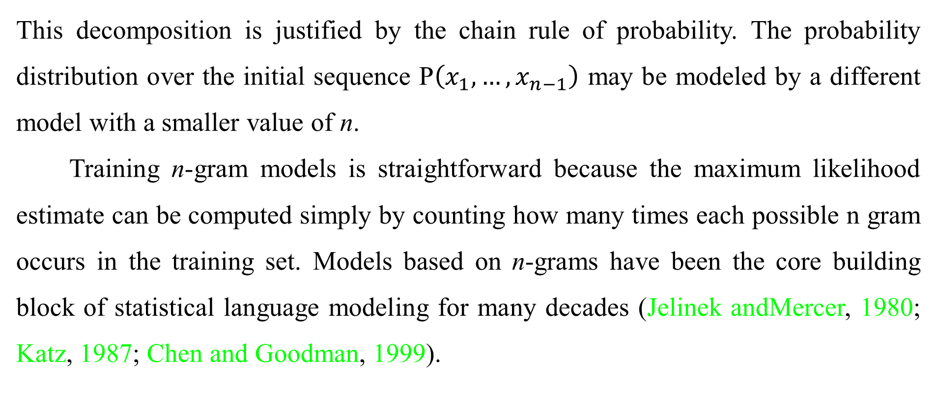
12.4.1 n-grams
This decomposition is justified by the chain rule of probability. The probability distribution over the initial sequence P$\left(x_{1},…,x_{n−1}\right)$ may be modeled by a different model with a smaller value of n.
Training n-gram models is straightforward because the maximum likelihood estimate can be computed simply by counting how many times each possible n gram occurs in the training set. Models based on n-grams have been the core building block of statistical language modeling for many decades (Jelinek andMercer, 1980; Katz, 1987; Chen and Goodman, 1999).

Slide 76

12.4.1 n-grams
For small values of n , models have particular names: unigram for n=1, bigram for n=2, and trigram for n=3. These names derive from the Latin prefixes for the corresponding numbers and the Greek suffix “-gram” denoting something that is written.
Usually we train both an n-gram model and an n − 1 .This makes it easy to compute
simply by looking up two stored probabilities. For this to exactly reproduce inference in P_{n}, we must omit the final character from each sequence when we train P_{n−1}.

Slide 77

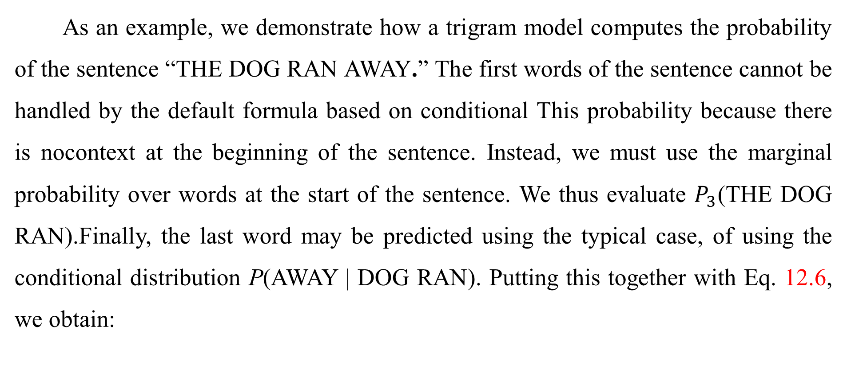
12.4.1 n-grams
As an example, we demonstrate how a trigram model computes the probability of the sentence “THE DOG RAN AWAY.” The first words of the sentence cannot be handled by the default formula based on conditional This probability because there is nocontext at the beginning of the sentence. Instead, we must use the marginal probability over words at the start of the sentence. We thus evaluate $P_{3}$(THE DOG RAN).Finally, the last word may be predicted using the typical case, of using the conditional distribution P(AWAY | DOG RAN). Putting this together with Eq. 12.6, we obtain:

Slide 78
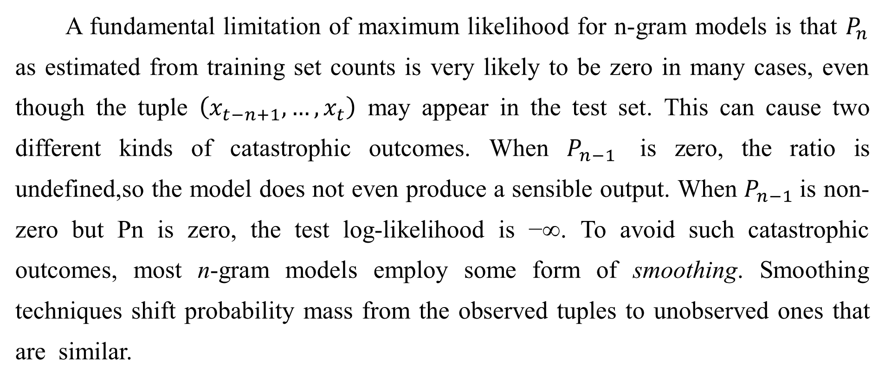
12.4.1 n-grams
A fundamental limitation of maximum likelihood for n-gram models is that $P_{n}$ as estimated from training set counts is very likely to be zero in many cases, even though the tuple $\left(x_{t−n+1},…,x_{t}\right)$ may appear in the test set. This can cause two different kinds of catastrophic outcomes. When $P_{n−1}$ is zero, the ratio is undefined,so the model does not even produce a sensible output. When $P_{n−1}$is non-zero but Pn is zero, the test log-likelihood is −∞. To avoid such catastrophic outcomes, most n-gram models employ some form of smoothing. Smoothing techniques shift probability mass from the observed tuples to unobserved ones that are similar.

Slide 79
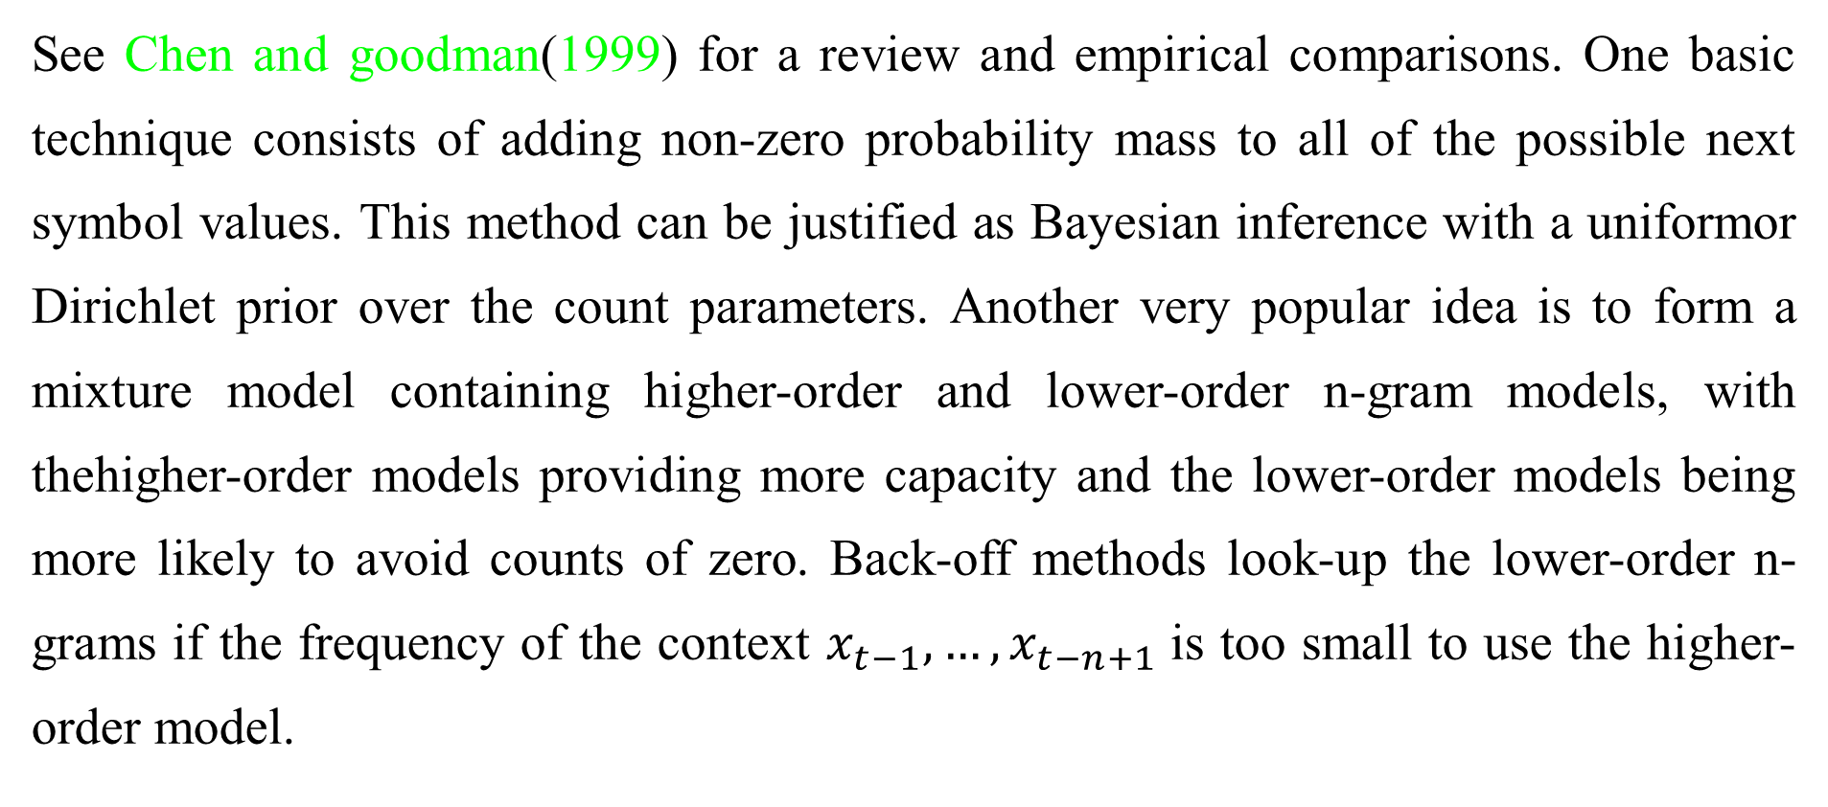
12.4.1 n-grams
See Chen and goodman(1999) for a review and empirical comparisons. One basic technique consists of adding non-zero probability mass to all of the possible next symbol values. This method can be justified as Bayesian inference with a uniformor Dirichlet prior over the count parameters. Another very popular idea is to form a mixture model containing higher-order and lower-order n-gram models, with thehigher-order models providing more capacity and the lower-order models being more likely to avoid counts of zero. Back-off methods look-up the lower-order n-grams if the frequency of the context $x_{t−1},…,x_{t−n+1}$is too small to use the higher-order model.

Slide 80
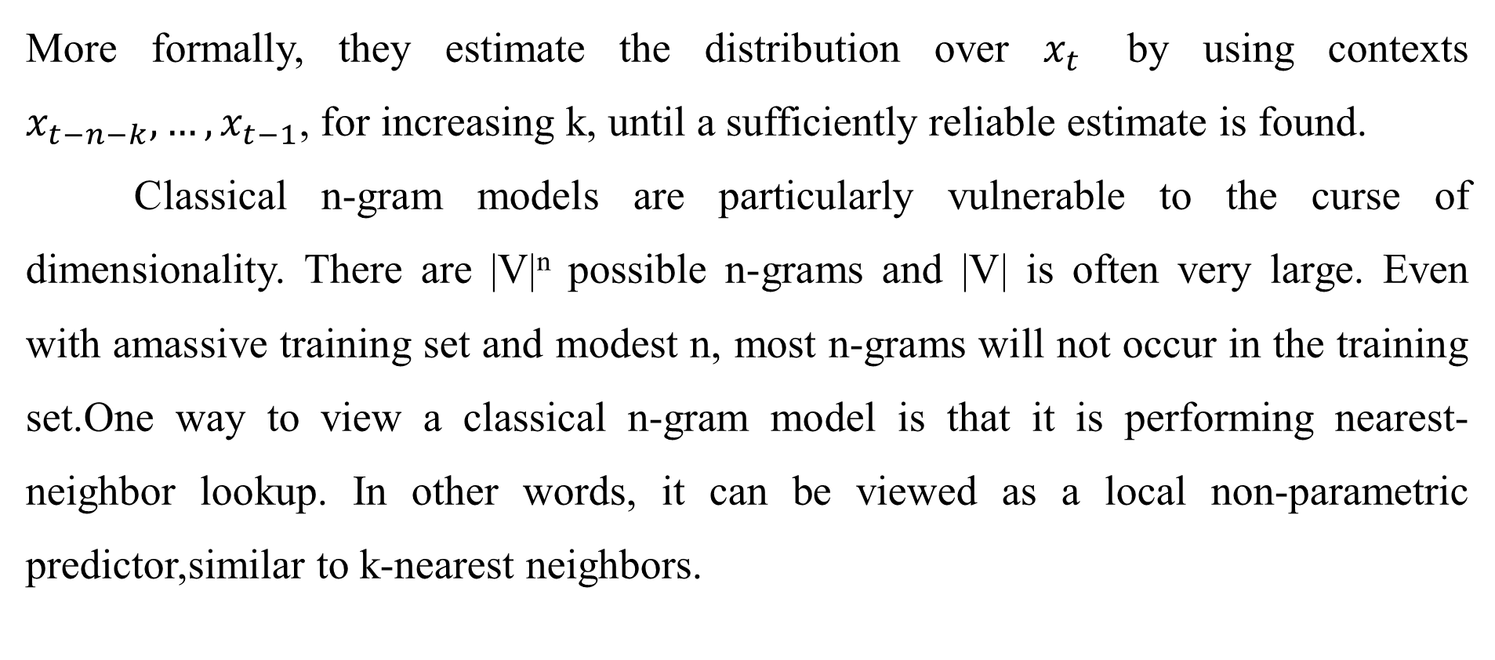
12.4.1 n-grams
More formally, they estimate the distribution over $x_{t}$ by using contexts $x_{t−n−k},…,x_{t−1}$, for increasing k, until a sufficiently reliable estimate is found.
Classical n-gram models are particularly vulnerable to the curse of dimensionality. There are |V|^{n} possible n-grams and |V| is often very large. Even with amassive training set and modest n, most n-grams will not occur in the training set.One way to view a classical n-gram model is that it is performing nearest-neighbor lookup. In other words, it can be viewed as a local non-parametric predictor,similar to k-nearest neighbors.

Slide 81
12.4.1 n-grams
The statistical problems facing these extremely local predictors are described in Sec. 5.11.2. The problem for a language model is even more severe than usual, because any two different words have the same distance from each other in one-hot vector space. It is thus difficult to leverage much.information from any “neighbors”—only training examples that repeat literally the same context are useful for local generalization. To overcome these problems a language model must be able to share knowledge between one word and other semantically similar words.

Slide 82
12.4.1 n-grams
To improve the statistical efficiency of n-gram models, class-model language models (Brown et al., 1992; Ney and Kneser, 1993; Niesler et al., 1998) introduce the notion of word categories and then share statistical strength between words that are in the same category. The idea is to use a clustering algorithm to partition the set of words into clusters or classes, based on their co-occurrence frequencies with other words. The model can then use word class IDs rather than individual word IDs to represent the context on the right side of the conditioning bar. Composite models combining word-based and class-based models via mixing or back-off are also possible. Although word classes provide a way to generalize between sequences in which some word is replaced by another of the same class, much information is lost in this representation.

Slide 83
12.4.2 Neural Language Models
Neural language models or NLMs are a class of language model designed to overcome the curse of dimensionality problem for modeling natural language sequences byusing a distributed representation of words (Bengio et al., 2001). Unlike classbased n-gram models, neural language models are able to recognize that two words.are similar without losing the ability to encode each word as distinct from the other. Neural language models share statistical strength between one word (and its context) and other similar words and contexts. The distributed representation the model to treat words that have features in common similarly.

Slide 84
12.4.2 Neural Language Models
For example, if the word dog and the word cat map to representations that share many attributes, then sentences that contain the word cat can inform the predictions that will be made by the model for sentences that contain the word dog, and vice-versa. Because there are many such attributes, there are many ways in which generalization can happen, transferring information from each training sentence to an exponentially largenumber of semantically related sentences. The curse of dimensionality requires the model to generalize to a number of sentences that is exponential in the sentence length. The model counters this curse by relating each training sentence to an exponential number of similar sentences.

Slide 85
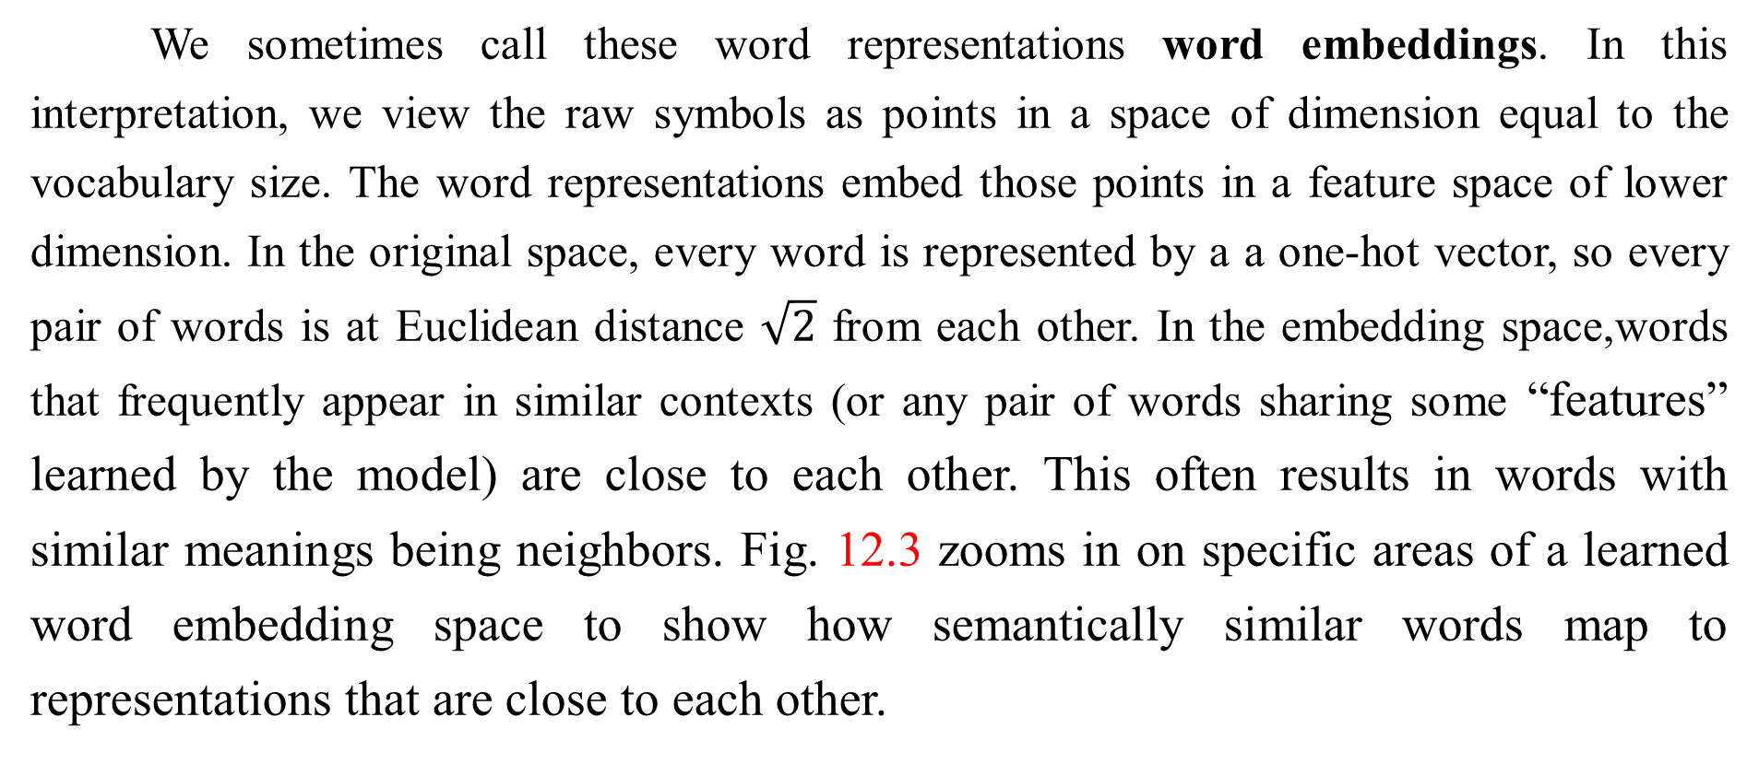
12.4.2 Neural Language Models
We sometimes call these word representations word embeddings. In this interpretation, we view the raw symbols as points in a space of dimension equal to the vocabulary size. The word representations embed those points in a feature space of lower dimension. In the original space, every word is represented by a a one-hot vector, so every pair of words is at Euclidean distance $\sqrt{2}$ from each other. In the embedding space,words that frequently appear in similar contexts (or any pair of words sharing some “features” learned by the model) are close to each other. This often results in words with similar meanings being neighbors. Fig. 12.3 zooms in on specific areas of a learned word embedding space to show how semantically similar words map to representations that are close to each other.

Slide 86
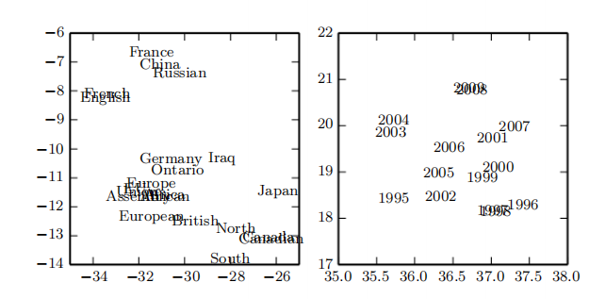
12.4.2 Neural Language Models
Figure 12.3: Two-dimensional visualizations of word embeddings obtained from a neural machine translation model (Bahdanau et al., 2015), zooming in on specific areas where semantically related words have embedding vectors that are close to each other. Countries appear on the left and numbers on the right. Keep in mind that these embeddings are 2-D for the purpose of visualization. In real applications, embeddings typically have higher dimensionality and can simultaneously capture many kinds of similarity between words.

Slide 87
12.4.2 Neural Language Models
Neural networks in other domains also define embeddings. For example, a hidden layer of a convolutional network provides an “image embedding.” Usually NLP practitioners are much more interested in this idea of embeddings because natural language frequently appear in similar contexts (or any pair of words sharing some “features” learned by the model) are close to each other. language does not originally lie in a real-valued vector space. The hidden layer has provided a more qualitatively dramatic change in the way the data is represented.

Slide 88
12.4.2 Neural Language Models
The basic idea of using distributed representations to improve models for natural language processing is not restricted to neural networks. It may also be used with graphical models that have distributed representations in the form of multiple latent variables (Mnih and Hinton, 2007).

Slide 89
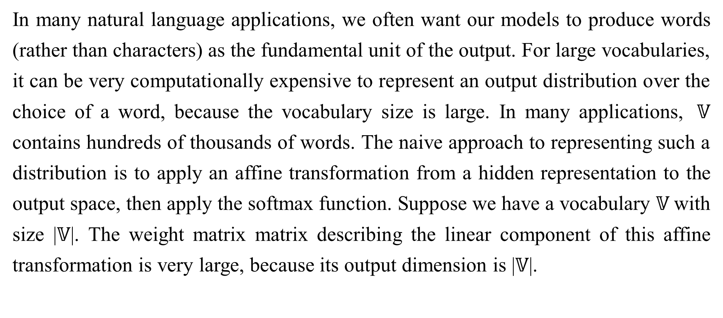
12.4.3 High-Dimensional outputs
In many natural language applications, we often want our models to produce words (rather than characters) as the fundamental unit of the output. For large vocabularies, it can be very computationally expensive to represent an output distribution over the choice of a word, because the vocabulary size is large. In many applications, $𝕍$ contains hundreds of thousands of words. The naive approach to representing such a distribution is to apply an affine transformation from a hidden representation to the output space, then apply the softmax function. Suppose we have a vocabulary $𝕍$with size |$𝕍$|. The weight matrix matrix describing the linear component of this affine transformation is very large, because its output dimension is |$𝕍$|.

Slide 90
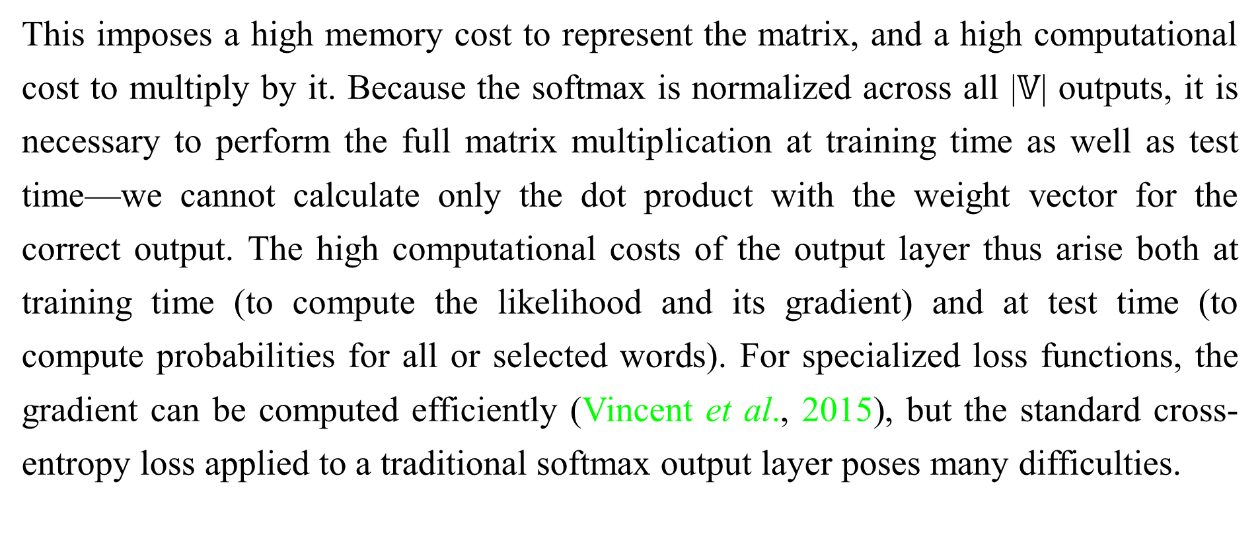
12.4.3 High-Dimensional outputs
This imposes a high memory cost to represent the matrix, and a high computational cost to multiply by it. Because the softmax is normalized across all |$𝕍$| outputs, it is necessary to perform the full matrix multiplication at training time as well as test time—we cannot calculate only the dot product with the weight vector for the correct output. The high computational costs of the output layer thus arise both at training time (to compute the likelihood and its gradient) and at test time (to compute probabilities for all or selected words). For specialized loss functions, the gradient can be computed efficiently (Vincent et al., 2015), but the standard cross-entropy loss applied to a traditional softmax output layer poses many difficulties.

Slide 91
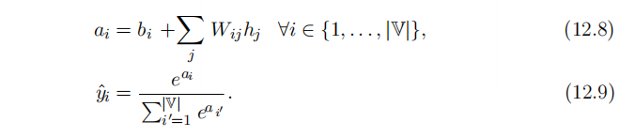
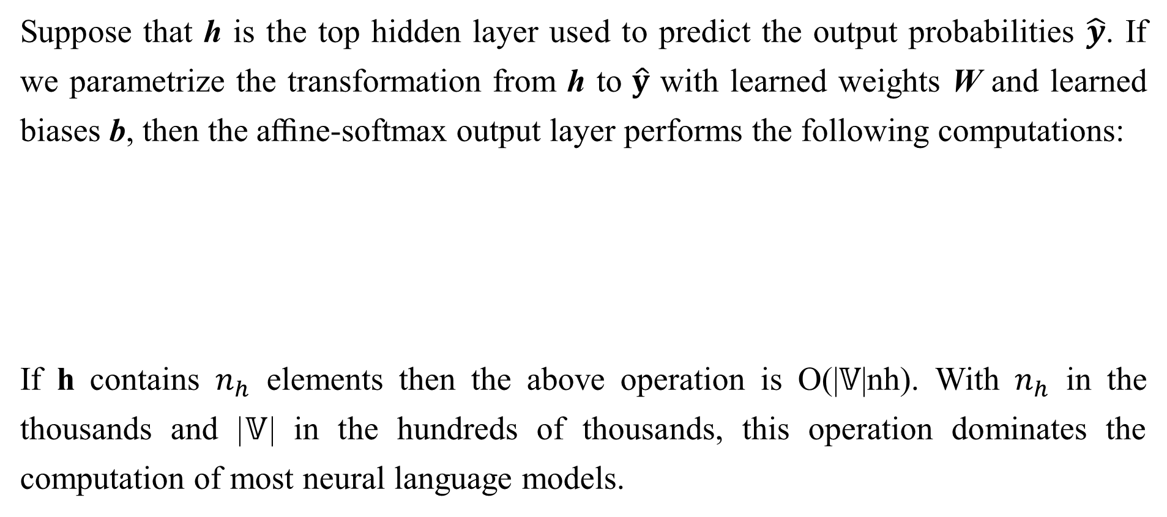
12.4.3 High-Dimensional outputs
Suppose that h is the top hidden layer used to predict the output probabilities $\hat{y}$. If we parametrize the transformation from h to $\hat{y}$ with learned weights W and learned biases b, then the aﬃne-softmax output layer performs the following computations:
If h contains $n_{h}$ elements then the above operation is O(|$𝕍$|nh). With $n_{h}$ in the thousands and |$𝕍$| in the hundreds of thousands, this operation dominates the computation of most neural language models.

Slide 92
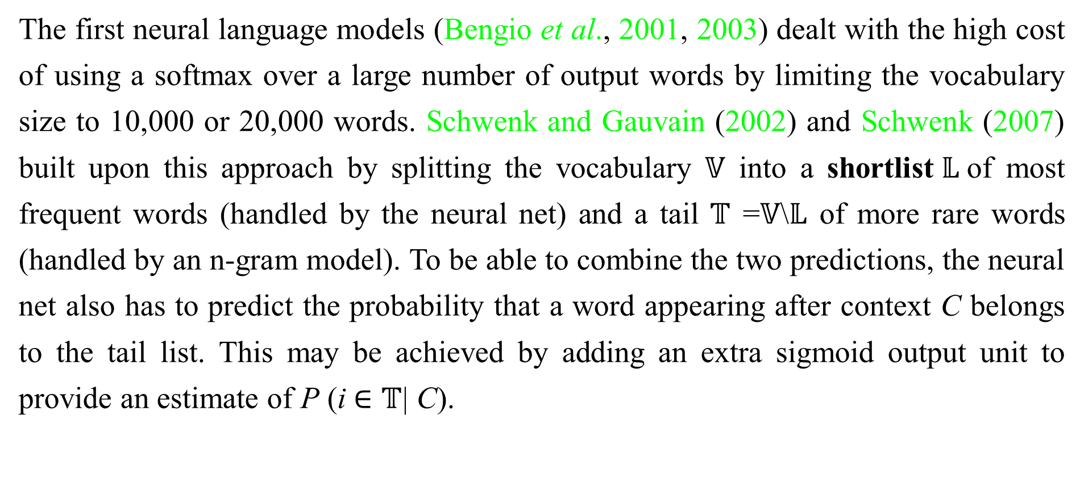
12.4.3.1 Use of Short List
The first neural language models (Bengio et al., 2001, 2003) dealt with the high cost of using a softmax over a large number of output words by limiting the vocabulary size to 10,000 or 20,000 words. Schwenk and Gauvain (2002) and Schwenk (2007) built upon this approach by splitting the vocabulary $𝕍$ into a shortlist$𝕃$of most frequent words (handled by the neural net) and a tail $𝕋$ =$𝕍$\$𝕃$ of more rare words (handled by an n-gram model). To be able to combine the two predictions, the neural net also has to predict the probability that a word appearing after context C belongs to the tail list. This may be achieved by adding an extra sigmoid output unit to provide an estimate of P (i $∈𝕋$| C).

Slide 93

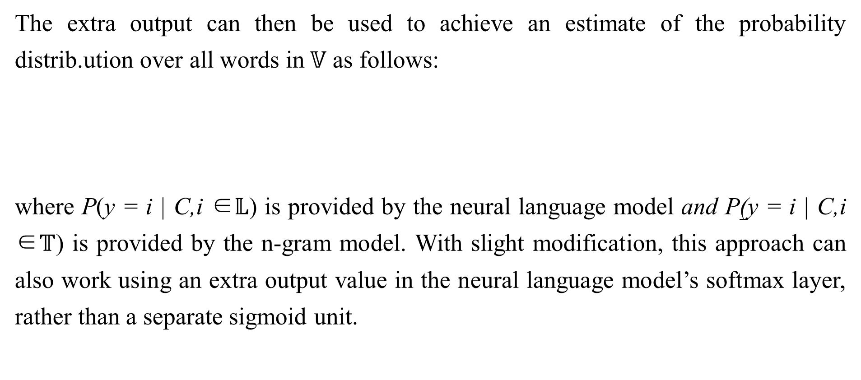
12.4.3.1 Use of Short List
The extra output can then be used to achieve an estimate of the probability distrib.ution over all words in$𝕍$ as follows:
where P(y = i | C,i ∈$𝕃$) is provided by the neural language model and P(y = i | C,i ∈$𝕋$) is provided by the n-gram model. With slight modification, this approach can also work using an extra output value in the neural language model’s softmax layer, rather than a separate sigmoid unit.

Slide 94
12.4.3.1 Use of Short List
An obvious disadvantage of the short list approach is that the potential generalization advantage of the neural language models is limited to the most frequent words, where, arguably, it is the least useful. This disadvantage has stimulated the exploration of alternative methods to deal with high-dimensional outputs, described below.

Slide 95
12.4.3.2 Hierarchical Softmax
A classical approach (Goodman, 2001) to reducing the computational burden of high-dimensional output layers over large vocabulary sets$𝕍$is to decompose probabilities hierarchically. Instead of necessitating a number of computations proportional to |$𝕍$| (and also proportional to the number of hidden units, $n_{h}$),the |$𝕍$| factor can be reduced to as low as log |$𝕍$|. Bengio (2002) and Morin and Bengio (2005) introduced this factorized approach to the context of neural language models.
One can think of this hierarchy as building categories of words, then categories of categories of words, then categories of categories of categories of words, etc. These nested categories form a tree, with words at the leaves. In a balanced tree, the tree has depth O(log |$𝕍$|).

Slide 96
12.4.3.2 Hierarchical Softmax
The probability of a choosing a word is given by the product of the probabilities of choosing the branch leading to that word at every node on a path from the root of the tree to the leaf containing the word. Fig. 12.4 illustrates a simple example. Mnih and Hinton (2009) also describe how to use multiple paths to identify a single word in order to better over model words that have multiple meanings. Computing the probability of a word then involves summation over all of the paths that lead to that word.

Slide 97
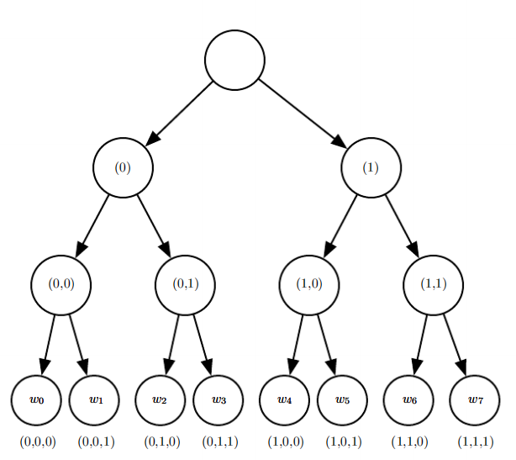
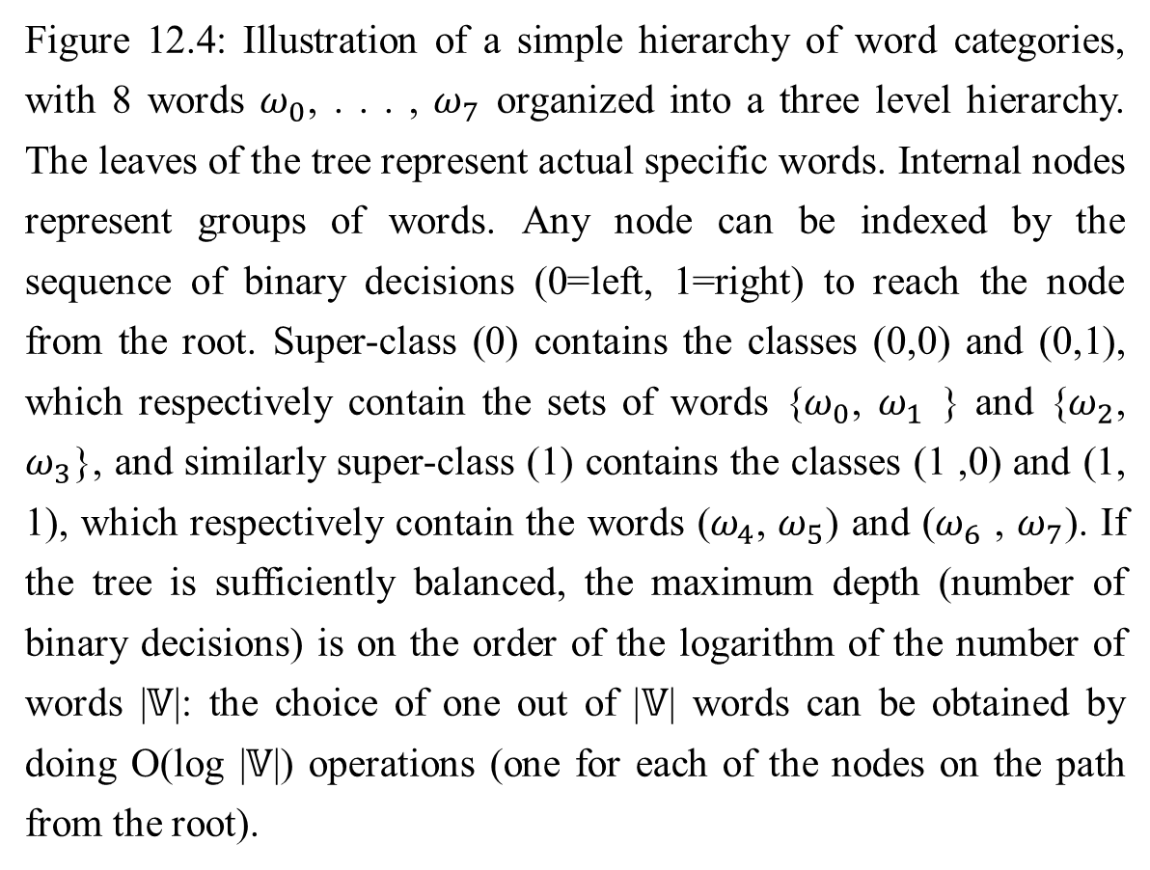
12.4.3.2 Hierarchical Softmax
Figure 12.4: Illustration of a simple hierarchy of word categories, with 8 words $ω_{0}$, . . . , $ω_{7}$ organized into a three level hierarchy. The leaves of the tree represent actual specific words. Internal nodes represent groups of words. Any node can be indexed by the sequence of binary decisions (0=left, 1=right) to reach the node from the root. Super-class (0) contains the classes (0,0) and (0,1), which respectively contain the sets of words {$ω_{0}$, $ω_{1}$ } and {$ω_{2}$, $ω_{3}$}, and similarly super-class (1) contains the classes (1 ,0) and (1, 1), which respectively contain the words ($ω_{4}$, $ω_{5}$) and ($ω_{6}$ , $ω_{7}$). If the tree is sufficiently balanced, the maximum depth (number of binary decisions) is on the order of the logarithm of the number of words |$𝕍$|: the choice of one out of |$𝕍$| words can be obtained by doing O(log |$𝕍$|) operations (one for each of the nodes on the path from the root).

Slide 98
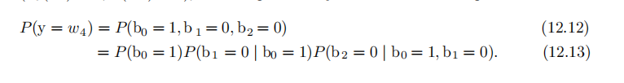
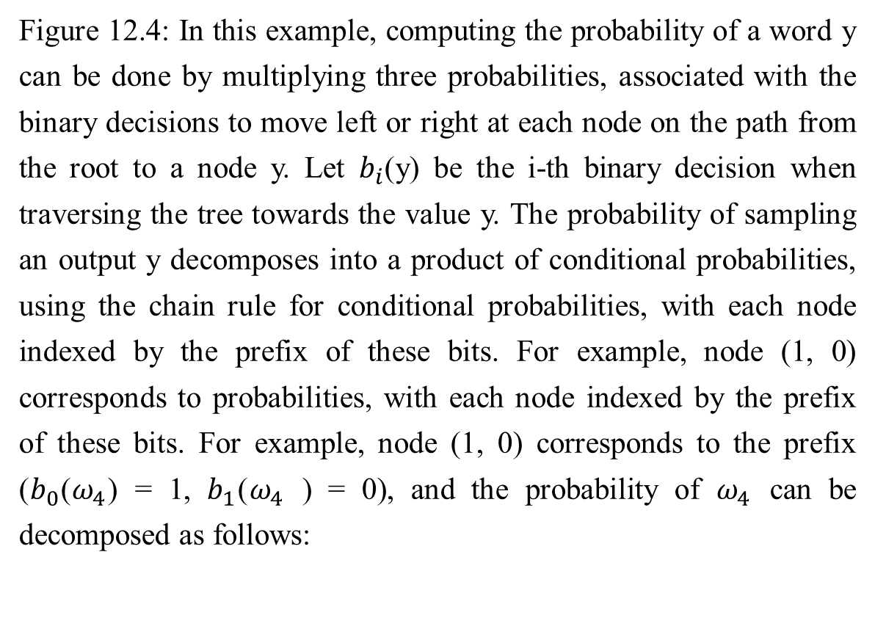
12.4.3.2 Hierarchical Softmax
Figure 12.4: In this example, computing the probability of a word y can be done by multiplying three probabilities, associated with the binary decisions to move left or right at each node on the path from the root to a node y. Let $b_{i}$(y) be the i-th binary decision when traversing the tree towards the value y. The probability of sampling an output y decomposes into a product of conditional probabilities, using the chain rule for conditional probabilities, with each node indexed by the prefix of these bits. For example, node (1, 0) corresponds to probabilities, with each node indexed by the prefix of these bits. For example, node (1, 0) corresponds to the prefix ($b_{0}$($ω_{4}$) = 1, $b_{1}$($ω_{4}$ ) = 0), and the probability of $ω_{4}$ can be decomposed as follows:

Slide 99
12.4.3.2 Hierarchical Softmax
To predict the conditional probabilities required at each node of the tree, we typically use a logistic regression model at each node of the tree, and provide the same context C as input to all of these models. Because the correct output is encoded in the training set, we can use supervised learning to train the logistic regression models. This is typically done using a standard cross-entropy loss,corresponding to maximizing the log-likelihood of the correct sequence of decisions.
Because the output log-likelihood can be computed eﬃciently (as low as log |$𝕍$| rather than |$𝕍$|), its gradients may also be computed eﬃciently. This includes not only the gradient with respect to the output parameters but also the gradients with respect to the hidden layer activations.

Slide 100
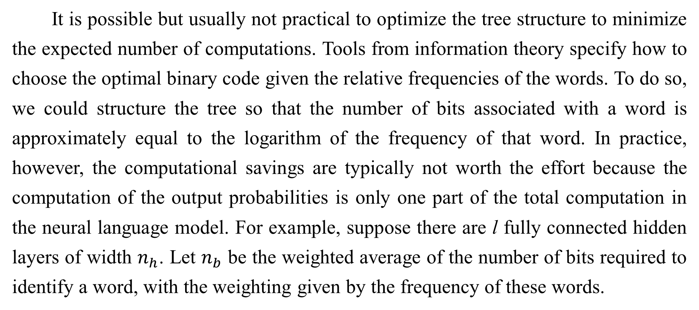
12.4.3.2 Hierarchical Softmax
It is possible but usually not practical to optimize the tree structure to minimize the expected number of computations. Tools from information theory specify how to choose the optimal binary code given the relative frequencies of the words. To do so, we could structure the tree so that the number of bits associated with a word is approximately equal to the logarithm of the frequency of that word. In practice, however, the computational savings are typically not worth the effort because the computation of the output probabilities is only one part of the total computation in the neural language model. For example, suppose there are l fully connected hidden layers of width $n_{h}$. Let $n_{b}$ be the weighted average of the number of bits required to identify a word, with the weighting given by the frequency of these words.

Slide 101
12.4.3.2 Hierarchical Softmax
In this example, the number of operations needed to compute the hidden activations grows as as O($\ln_{h}^{2}$) while the output computations grow as O($n_{h}n_{b}$).As long as $n_{b}$ ≤ $\ln{h}$, we can reduce computation more by shrinking $n_{h}$ than by shrinking $n_{b}$. Indeed, $n_{b}$ is often small. Because the size of the vocabulary rarely exceeds a million words and $\log_{2}{{10}^{6}≈20},$it is possible to reduce $n_{b}$ to about 20, but $n_{h}$ is often much larger, around ${10}^{3}$or more. Rather than carefully optimizing a tree with a branching factor of 2, one can instead deﬁne a tree with depth two and a branching factor of|$𝕍$|. Such a tree corresponds to simply deﬁning a set of mutually exclusive word classes. The simple approach based on a tree of depth two captures most of the computational beneﬁt of the hierarchical strategy.

Slide 102
12.4.3.2 Hierarchical Softmax
One question that remains somewhat open is how to best define these word classes, or how to define the word hierarchy in general. Early work used existing hierarchies (Morin and Bengio, 2005) but the hierarchy can also be learned, ideally jointly with the neural language model. Learning the hierarchy is difficult. An exact optimization of the log-likelihood appears intractable because the choice of a word hierarchy is a discrete one, not amenable to gradient-based optimization. However, one could use discrete optimization to approximately optimize the partition of words into word classes.

Slide 103
12.4.3.2 Hierarchical Softmax
An important advantage of the hierarchical softmax is that it brings computational benefits both at training time and at test time, if at test time we want to compute the probability of specific words.
Of course, computing the probability of all |$𝕍$| words will remain expensive even with the hierarchical softmax. Another important operation is selecting the most likely word in a given context. Unfortunately the tree structure does not provide an eﬃcient and exact solution to this problem.
A disadvantage is that in practice the hierarchical softmax tends to give worse test results than sampling-based methods we will describe next. This may be due to a poor choice of word classes.

Slide 104
12.4.3.3 Importance Sampling
One way to speed up the training of neural language models is to avoid explicitly computing the contribution of the gradient from all of the words that do not appear in the next position. Every incorrect word should have low probability under the model. It can be computationally costly to enumerate all of these words. Instead, it is possible to sample only a subset of the words. Using the notation introduced in Eq. 12.8, the gradient can be written as follows:
$\frac{∂log P(y|C)}{∂θ}= \frac{∂\log{{softmax}_{y}(a)}}{∂θ}$ (12.13)
$=\frac{∂}{∂θ}$ log $\frac{e^{a_{y}}}{\sum_{i}{e^{a_{i}}}}$ (12.14)
$=\frac{∂}{∂θ}$ ($a_{y}−$ log $\sum_{i}{e^{a_{i}}}$) (12.15)
$=\frac{∂a_{y}}{∂θ} −$ $\sum_{i}{P(y=i|C)}\frac{∂a_{i}}{∂θ}$ (12.16)

Slide 105
12.4.3.3 Importance Sampling
where a is the vector of pre-softmax activations (or scores), with one element per word. The first term is the positive phase term (pushing $a_{y}$ up) while the second term is the negative phase term (pushing $a_{i}$ down for all i, with weight P (i | C). Since the negative phase term is an expectation, we can estimate it with a Monte Carlo sample. However, that would require sampling from the model itself. Sampling from the model requires computing P (i | C) for all i in the vocabulary, which is precisely what we are trying to avoid.

Slide 106
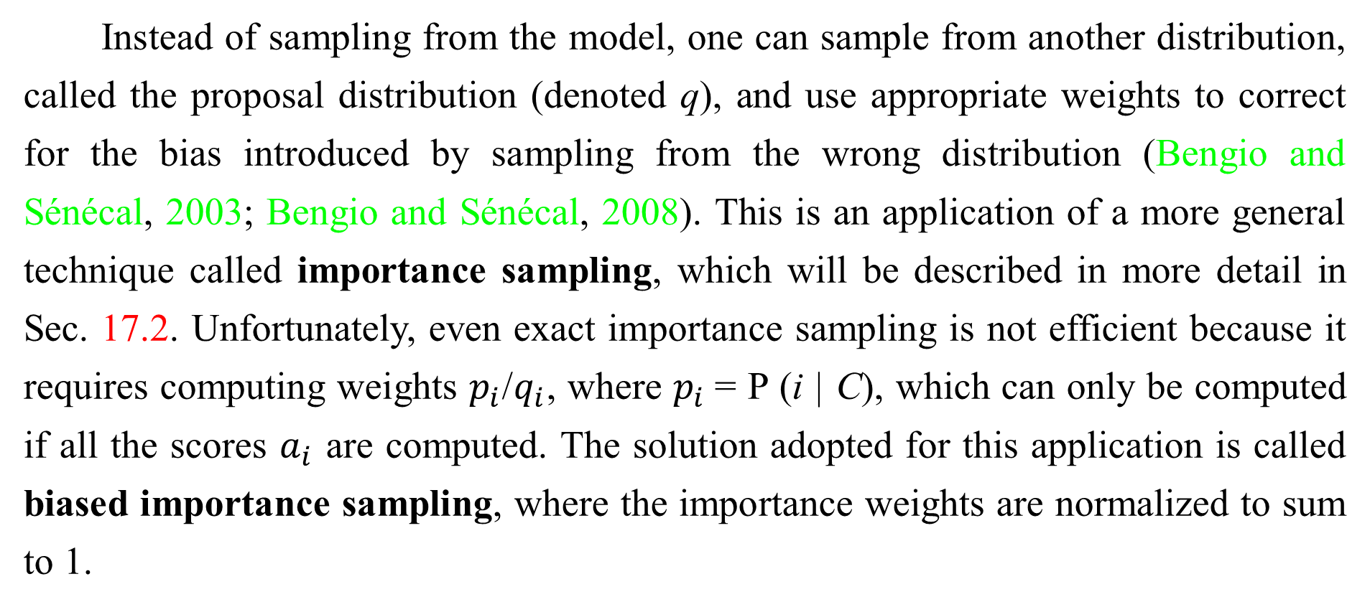
12.4.3.3 Importance Sampling
Instead of sampling from the model, one can sample from another distribution, called the proposal distribution (denoted q), and use appropriate weights to correct for the bias introduced by sampling from the wrong distribution (Bengio and Sénécal, 2003; Bengio and Sénécal, 2008). This is an application of a more general technique called importance sampling, which will be described in more detail in Sec. 17.2. Unfortunately, even exact importance sampling is not efficient because it requires computing weights $p_{i}$/$q_{i}$, where $p_{i}$= P (i | C), which can only be computed if all the scores $a_{i}$ are computed. The solution adopted for this application is called biased importance sampling, where the importance weights are normalized to sum to 1.

Slide 107
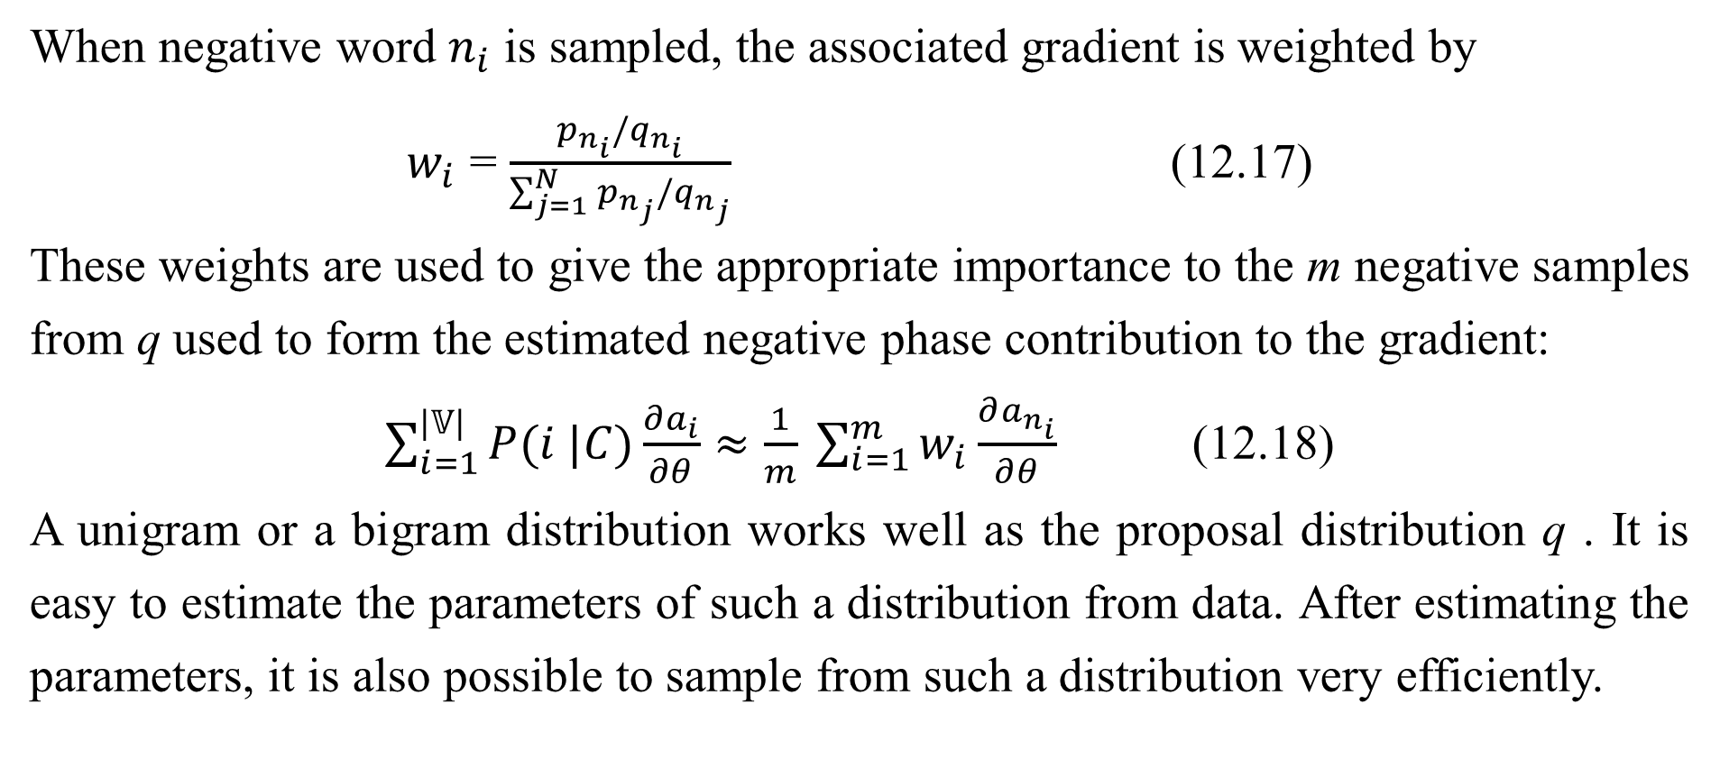
12.4.3.3 Importance Sampling
When negative word $n_{i}$ is sampled, the associated gradient is weighted by
$w_{i}$ = $\frac{p_{n_{i}}/q_{n_{i}}}{\sum_{j=1}^{N}{p_{n_{j}}/q_{n_{j}}}}$ (12.17)
These weights are used to give the appropriate importance to the m negative samples from q used to form the estimated negative phase contribution to the gradient:
$\sum_{i=1}^{|𝕍|}{P(i |C)}\frac{∂a_{i}}{∂θ}≈\frac{1}{m} \sum_{i=1}^{m}{w_{i}\frac{∂a_{n_{i}}}{∂θ}}$ (12.18)
A unigram or a bigram distribution works well as the proposal distribution q . It is easy to estimate the parameters of such a distribution from data. After estimating the parameters, it is also possible to sample from such a distribution very efficiently.

Slide 108
12.4.3.3 Importance Sampling
Importance sampling is not only useful for speeding up models with large softmax outputs. More generally, it is useful for accelerating training with large sparse output layers, where the output is a sparse vector rather than a -of- 1 n choice. An example is a bag of words. A bag of words is a sparse vector v where $v_{i}$ indicates the presence or absence of word i from the vocabulary in the document. Alternately, $v_{i}$ can indicate the number of times that word i appears. Machine learning models that emit such sparse vectors can be expensive to train for a variety of reasons. Early in learning, the model may not actually choose to make the output truly sparse. Moreover, the loss function we use for training might most naturally be described in terms of comparing every element of the output to every element of the target.

Slide 109
12.4.3.3 Importance Sampling
This means that it is not always clear that there is a computational benefit to using sparse outputs, because the model may choose to make the majority of the output non-zero and all of these non-zero values need to be compared to the corresponding training target, even if the training target is zero. Dauphin et al. (2011) demonstrated that such models can be accelerated using importance sampling. The efficient algorithm minimizes the loss reconstruction for the “positive words” (those that are non-zero in the target) and an equal number of “negative words.” The negative words are chosen randomly, using a heuristic to sample words that are more likely to be mistaken. The bias introduced by this heuristic oversampling can then be corrected using importance weights.
(

Slide 110
12.4.3.3 Importance Sampling
In all of these cases, the computational complexity of gradient estimation for the output layer is reduced to be proportional to the number of negative samples rather than proportional to the size of the output vector.

Slide 111
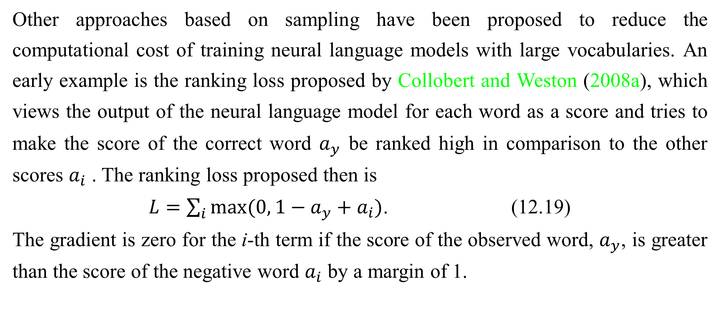
12.4.3.4 Noise-Contrastive Estimation and Ranking Loss
Other approaches based on sampling have been proposed to reduce the computational cost of training neural language models with large vocabularies. An early example is the ranking loss proposed by Collobert and Weston (2008a), which views the output of the neural language model for each word as a score and tries to make the score of the correct word $a_{y}$ be ranked high in comparison to the other scores $a_{i}$ . The ranking loss proposed then is
$L=\sum_{i}{max⁡(0, 1−a_{y}+a_{i})}$. (12.19)
The gradient is zero for the i-th term if the score of the observed word, $a_{y}$, is greater than the score of the negative word $a_{i}$ by a margin of 1.

Slide 112
12.4.3.4 Noise-Contrastive Estimation and Ranking Loss
One issue with this criterion is that it does not provide estimated conditional probabilities, which are useful in some applications, including speech recognition and text generation (including conditional text generation tasks such as translation).
A more recently used training objective for neural language model is noise- contrastive estimation, which is introduced in Sec. 18.6. This approach has been successfully applied to neural language models (Mnih and Teh, 2012; Mnih and Kavukcuoglu, 2013).

Slide 113
12.4.4 Combining Neural Language Models with n-grams
A major advantage of n-gram models over neural networks is that n -gram models achieve high model capacity (by storing the frequencies of very many tuples) while requiring very little computation to process an example (by looking up only a few tuples that match the current context). If we use hash tables or trees to access the counts, the computation used for n-grams is almost independent of capacity. In comparison, doubling a neural network’s number of parameters typically also roughly doubles its computation time. Exceptions include models that avoid using all parameters on each pass. Embedding layers index only a single embedding in each pass, so we can increase the vocabulary size without increasing the computation time per example.

Slide 114
12.4.4 Combining Neural Language Models with n-grams
Some other models, such as tiled convolutional networks, can add parameters while reducing the degree of parameter sharing in order to maintain the same amount of computation. However, typical neural network layers based on matrix multiplication use an amount of computation proportional to the number of parameters.
One easy way to add capacity is thus to combine both approaches in an ensemble consisting of a neural language model and an n -gram language model (Bengio et al., 2001, 2003). As with any ensemble, this technique can reduce test error if the ensemble members make independent mistakes. The field of ensemble learning provides many ways of combining the ensemble members’ predictions, including uniform weighting and weights chosen on a validation set.

Slide 115
12.4.4 Combining Neural Language Models with n-grams
Mikolov et al. (2011a) extended the ensemble to include not just two models but a large array of models. It is also possible to pair a neural network with a maximum entropy model and train both jointly (Mikolov et al., 2011b). This approach can be viewed as training a neural network with an extra set of inputs that are connected directly to the output, and not connected to any other part of the model. The extra inputs are indicators for the presence of particular n-grams in the input context, so these variables are very high-dimensional and very sparse. The increase in model capacity is huge—the new portion of the architecture contains up to ${|sV|}^{n}$ parameters—but the amount of added computation needed to process an input is minimal because the extra inputs are very sparse.

Slide 116
12.4.5 Neural Machine Translation
Machine translation is the task of reading a sentence in one natural language and emitting a sentence with the equivalent meaning in another language. Machine translation systems often involve many components. At a high level, there is often one component that proposes many candidate translations. Many of these translations will not be grammatical due to differences between the languages. For example, many languages put adjectives after nouns, so when translated to English directly they yield phrases such as “apple red.” The proposal mechanism suggests many variants of the suggested translation, ideally including “red apple.” A second component of the translation system, a language model, evaluates the proposed translations, and can score “red apple” as better than “apple red.”

Slide 117
12.4.5 Neural Machine Translation
The earliest use of neural networks for machine translation was to upgrade the language model of a translation system by using a neural language model (Schwenk et al., 2006; Schwenk, 2010). Previously, most machine translation systems had used an n -gram model for this component. The n-gram based models used for machine translation include not just traditional back-off n -gram models (Jelinek and Mercer, 1980; Katz, 1987; Chen and Goodman, 1999) but also maximum entropy language models (Berger et al., 1996), in which an affine-softmax layer predicts the next word given the presence of frequent n-grams in the context.
Traditional language models simply report the probability of a natural language sentence.

Slide 118
12.4.5 Neural Machine Translation
Because machine translation involves producing an output sentence given an input sentence, it makes sense to extend the natural language model to be conditional. As described in Sec. 6.2.1.1, it is straightforward to extend a model that defines a marginal distribution over some variable to define a conditional distribution over that variable given a context C, where C might be a single variable or a list of variables. Devlin et al. (2014) beat the state-of-the-art in some statistical machine translation benchmarks by using an MLP to score a phrase $t_{1}$,$t_{2}$,...,$t_{k}$ in the target language given a phrase $s_{1}$,$s_{2}$,...,$s_{n}$ in the source language. The MLP estimates P($t_{1}$,$t_{2}$,...,$t_{k} |{ s}_{1}$,$s_{2}$,...,$s_{n}$). The estimate formed by this MLP replaces the estimate provided by conditional n-gram models.

Slide 119
12.4.5 Neural Machine Translation
A drawback of the MLP-based approach is that it requires the sequences to be preprocessed to be of fixed length. To make the translation more flexible, we would like to use a model that can accommodate variable length inputs and variable length outputs. An RNN provides this ability. Sec. 10.2.4 describes several ways of constructing an RNN that represents a conditional distribution over a sequence given some input, and Sec. 10.4 describes how to accomplish this conditioning when the input is a sequence. In all cases, one model first reads the input sequence and emits a data structure that summarizes the input sequence. We call this summary the “context” C.

Slide 120
12.4.5 Neural Machine Translation
The context C may be a list of vectors, or it may be a vector or tensor. The model that reads the input to produce C may be an RNN (Cho et al., 2014a; Sutskever et al., 2014; Jean et al., 2014) or a convolutional network (Kalchbrenner and Blunsom, 2013). A second model, usually an RNN, then reads the context C and generates a sentence in the target language. This general idea of an encoder-decoder framework for machine translation is illustrated in Fig. 12.5.
In order to generate an entire sentence conditioned on the source sentence, the model must have a way to represent the entire source sentence. Earlier models were only able to represent individual words or phrases.

Slide 121
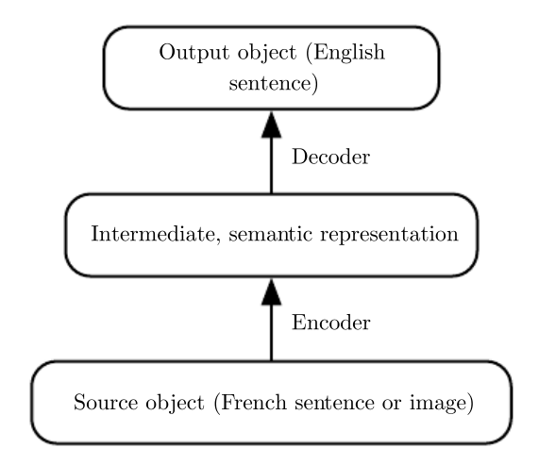
12.4.5 Neural Machine Translation
Figure 12.5: The encoder-decoder architecture to map back and forth between a surface representation (such as a sequence of words or an image) and a semantic representation. By using the output of an encoder of data from one modality (such as the encoder mapping from French sentences to hidden representations capturing the meaning of sentences) as the input to a decoder for another modality (such as the decoder mapping from hidden representations capturing the meaning of sentences to English), we can train systems that translate from one modality to another. This idea has been applied successfully not just to machine translation but also to caption generation from images.

Slide 122
12.4.5 Neural Machine Translation
From a representation learning point of view, it can be useful to learn a representation in which sentences that have the same meaning have similar representations regardless of whether they were written in the source language or the target language. This strategy was explored first using a combination of convolutions and RNNs (Kalchbrenner and Blunsom, 2013). Later work introduced the use of an RNN for scoring proposed translations (Cho et al., 2014a) and for generating translated sentences (Sutskever et al., 2014). Jean et al. (2014) scaled these models to larger vocabularies.

Slide 123
12.4.5.1 Using an Attention Mechanism and Aligning Pieces of Data
Using a fixed-size representation to capture all the semantic details of a very long sentence of say 60 words is very difficult. It can be achieved by training a sufficiently large RNN well enough and for long enough, as demonstrated by Cho et al. (2014a) and Sutskever et al. (2014). However, a more efficient approach is to read the whole sentence or paragraph (to get the context and the gist of what is being expressed), then produce the translated words one at a time, each time focusing on a different part of the input sentence in order to gather the semantic details that are required to produce the next output word. That is exactly the idea that Bahdanau et al. (2015) first introduced. The attention mechanism used to focus on specific parts of the input sequence at each time step is illustrated in Fig. 12.6.

Slide 124
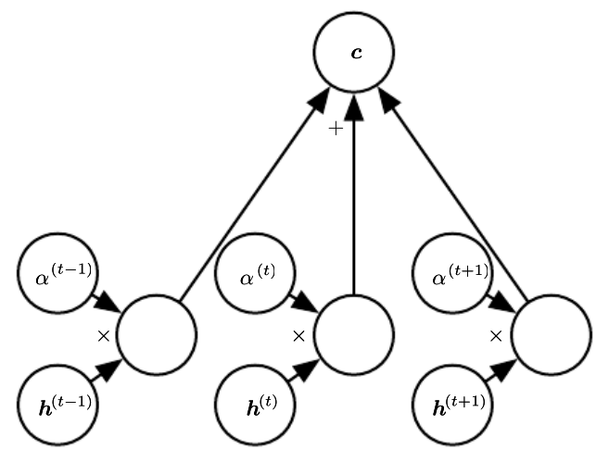
12.4.5.1 Using an Attention Mechanism and Aligning Pieces of Data
Figure 12.6: A modern attention mechanism, as introduced by Bahdanau et al. (2015), is essentially a weighted average. A context vector c is formed by taking a weighted average of feature vectors $h^{(t)}$ with weights $α^{(t)}$. In some applications, the feature vectors h are hidden units of a neural network, but they may also be raw input to the model. The weights $α^{(t)}$ are produced by the model itself. They are usually values in the interval [0,1] and are intended to concentrate around just one $h^{(t)}$so that the weighted average approximates reading that one specific time step precisely. The weights $α^{(t)}$ are usually produced by applying a softmax function to relevance scores emitted by another portion of the model. The attention mechanism is more expensive computationally than directly indexing the desired $h^{(t)}$, but direct indexing cannot be trained with gradient descent. The attention mechanism based on weighted averages is a smooth, differentiable approximation that can be trained with existing optimization algorithms.

Slide 125
12.4.5.1 Using an Attention Mechanism and Aligning Pieces of Data
We can think of an attention-based system as having three components:
A process that reads raw data (such as source words in a source sentence), and converts them into distributed representations, with one feature vector associated with each word position.
A list of feature vectors storing the output of the reader. This can be understood as a memory containing a sequence of facts, which can be memory retrieved later, not necessarily in the same order, without having to visit all of them.
A process that exploits the content of the memory to sequentially perform exploits a task, at each time step having the ability put attention on the content of one memory element (or a few, with a different weight).

Slide 126
12.4.5.1 Using an Attention Mechanism and Aligning Pieces of Data
The third component generates the translated sentence.
When words in a sentence written in one language are aligned with corresponding words in a translated sentence in another language, it becomes possible to relate the corresponding word embeddings. Earlier work showed that one could learn a kind of translation matrix relating the word embeddings in one language with the word embeddings in another (Kočiský et al., 2014), yielding lower alignment error rates than traditional approaches based on the frequency counts in the phrase table. There is even earlier work on learning cross-lingual word vectors (Klementiev et al., 2012). Many extensions to this approach are possible. For example, more efficient cross-lingual alignment (Gouws et al., 2014) allows training on larger datasets.

Slide 127
12.4.6 Historical Perspective
The idea of distributed representations for symbols was introduced by Rumelhart et al. (1986a) in one of the first explorations of back-propagation, with symbols corresponding to the identity of family members and the neural network capturing the relationships between family members, with training examples forming triplets such as (Colin, Mother, Victoria). The first layer of the neural network learned a representation of each family member. For example, the features for Colin might represent which family tree Colin was in, what branch of that tree he was in, what generation he was from, etc. One can think of the neural network as computing learned rules relating these attributes together in order to obtain the desired predictions. The model can then make predictions such as inferring who is the mother of Colin.

Slide 128
12.4.6 Historical Perspective
The idea of forming an embedding for a symbol was extended to the idea of an embedding for a word by Deerwester et al. (1990). These embeddings were learned using the SVD. Later, embeddings would be learned by neural networks.
The history of natural language processing is marked by transitions in the popularity of different ways of representing the input to the model. Following this early work on symbols or words, some of the earliest applications of neural networks to NLP (Miikkulainen and Dyer, 1991; Schmidhuber, 1996) represented the input as a sequence of characters.

Slide 129
12.4.6 Historical Perspective
Bengio et al. (2001) returned the focus to modeling words and introduced neural language models, which produce interpretable word embeddings. These neural models have scaled up from defining representations of a small set of symbols in the 1980s to millions of words (including proper nouns and misspellings) in modern applications. This computational scaling effort led to the invention of the techniques described above in Sec. 12.4.3.
Initially, the use of words as the fundamental units of language models yielded improved language modeling performance (Bengio et al., 2001). To this day, new techniques continually push both character-based models (Sutskever et al., 2011) and word-based models forward, with recent work (Gillick et al., 2015) even modeling individual bytes of Unicode characters.

Slide 130
12.4.6 Historical Perspective
The ideas behind neural language models have been extended into several natural language processing applications, such as parsing (Henderson, 2003, 2004; Collobert, 2011), part-of-speech tagging, semantic role labeling, chunking, etc, sometimes using a single multi-task learning architecture (Collobert and Weston, 2008a; Collobert et al., 2011a) in which the word embeddings are shared across tasks.
Two-dimensional visualizations of embeddings became a popular tool for analyzing language models following the development of the t-SNE dimensionality reduction algorithm (van der Maaten and Hinton, 2008) and its high-profile application to visualization word embeddings by Joseph Turian in 2009.

Slide 131
Chapter 12 Applications
12.5 Other Applications
Acknowledge to: Liande Bi
Organizers: Guoqiang Zhong, Zhaoyang Niu
Machine Learning Research Group
Ocean University of China
Qingdao, China
https://github.com/AdolfKing/DeepLearningSlides

Slide 132
12.5 Other Applications
In this section we cover a few other types of applications of deep learning that are different from the standard object recognition, speech recognition and natural language processing tasks discussed above. Part III of this book will expand that scope even further to include tasks requiring the ability to generate rich high-dimensional samples (unlike “the next word,” in language models).

Slide 133
12.5.1 Recommender Systems
One of the major families of applications of machine learning in the information technology sector is the ability to make recommendations of items to potential users or customers. Two major types of applications can be distinguished: online advertising and item recommendations (often these recommendations are still for the purpose of selling a product). Both rely on predicting the association between a user and an item, either to predict the probability of some action (the user buying the product, or some proxy for this action) or the expected gain (which may depend on the value of the product) if an ad is shown or a recommendation is made regarding that product to that user. The internet is currently financed in great part by various forms of online advertising.

Slide 134
12.5.1 Recommender Systems
There are major parts of the economy that rely on online shopping. Companies including Amazon and eBay use machine learning, including deep learning, for their product recommendations. Sometimes, the items are not products that are actually for sale. Examples include selecting posts to display on social network news feeds, recommending movies to watch, recommending jokes, recommending advice from experts, matching players for video games, or matching people in dating services.
Often, this association problem is handled like a supervised learning problem: given some information about the item and about the user, predict the proxy of interest (user clicks on ad, user enters a rating, user clicks on a “like” button, user buys product, user spends some amount of money on the product, user spends time visiting a page for the product, etc.).

Slide 135
12.5.1 Recommender Systems
This often ends up being either a regression problem (predicting some conditional expected value) or a probabilistic classification problem (predicting the conditional probability of some discrete event).
The early work on recommender systems relied on minimal information as inputs for these predictions: the user ID and the item ID. In this context, the only way to generalize is to rely on the similarity between the patterns of values of the target variable for different users or for different items. Suppose that user 1 and user 2 both like items A, B and C. From this, we may infer that user 1 and user 2 have similar tastes. If user 1 likes item D, then this should be a strong cue that user 2 will also like D. Algorithms based on this principle come under the name of collaborative filtering.

Slide 136
12.5.1 Recommender Systems
Both non-parametric approaches (such as nearest-neighbor methods based on the estimated similarity between patterns of preferences) and parametric methods are possible. Parametric methods often rely on learning a distributed representation (also called an embedding) for each user and for each item. Bilinear prediction of the target variable (such as a rating) is a simple parametric method that is highly successful and often found as a component of state-of-the-art systems. The prediction is obtained by the dot product between the user embedding and the item embedding (possibly corrected by constants that depend only on either the user ID or the item ID). Let $\hat{R}$ be the matrix containing our predictions, A a matrix with user embeddings in its rows and B a matrix with item embeddings in its columns.

Slide 137
12.5.1 Recommender Systems
Let b and c be vectors that contain respectively a kind of bias for each user (representing how grumpy or positive that user is in general) and for each item (representing its general popularity). The bilinear prediction is thus obtained as follows:
$\hat{R_{u,i}}= b_{u}+$ $c_{i}+\sum_{j}{A_{u,j}B_{j,i}.}$ (12.20)
Typically one wants to minimize the squared error between predicted ratings $\hat{R_{u,i}}$and actual ratings $R_{u,i}$ . User embeddings and item embeddings can then be conveniently visualized when they are first reduced to a low dimension (two or three), or they can be used to compare users or items against each other, just like word embeddings. One way to obtain these embeddings is by performing a singular value decomposition of the matrix R of actual targets (such as ratings).

Slide 138
12.5.1 Recommender Systems
This corresponds to factorizing R = UDV' (or a normalized variant) into the product of two factors, the lower rank matrices A = UD and B = V' . One problem with the SVD is that it treats the missing entries in an arbitrary way, as if they corresponded to a target value of 0. Instead we would like to avoid paying any cost for the predictions made on missing entries. Fortunately, the sum of squared errors on the observed ratings can also be easily minimized by gradient-based optimization. The SVD and the bilinear prediction of Eq. 12.21 both performed very well in the competition for the Netflix prize (Bennett and Lanning, 2007), aiming at predicting ratings for films, based only on previous ratings by a large set of anonymous users. Many machine learning experts participated in this competition, which took place between 2006 and 2009.

Slide 139
12.5.1 Recommender Systems
It raised the level of research in recommender systems using advanced machine learning and yielded improvements in recommender systems. Even though it did not win by itself, the simple bilinear prediction or SVD was a component of the ensemble models presented by most of the competitors, including the winners ( Töscher et al., 2009; Koren, 2009).
Beyond these bilinear models with distributed representations, one of the first uses of neural networks for collaborative filtering is based on the RBM undirected probabilistic model (Salakhutdinov et al., 2007). RBMs were an important element of the ensemble of methods that won the Netflix competition (Töscher et al., 2009; Koren, 2009). More advanced variants on the idea of factorizing the ratings matrix have also been explored in the neural networks community (Salakhutdinov and Mnih, 2008).

Slide 140
12.5.1 Recommender Systems
However, there is a basic limitation of collaborative filtering systems: when a new item or a new user is introduced, its lack of rating history means that there is no way to evaluate its similarity with other items or users (respectively), or the degree of association between, say, that new user and existing items. This is called the problem of cold-start recommendations. A general way of solving the cold-start recommendation problem is to introduce extra information about the individual users and items. For example, this extra information could be user profile information or features of each item. Systems that use such information are called content-based recommender systems. The mapping from a rich set of user features or item features to an embedding can be learned through a deep learning architecture (Huang et al., 2013; Elkahky et al., 2015).

Slide 141
12.5.1 Recommender Systems
Specialized deep learning architectures such as convolutional networks have also been applied to learn to extract features from rich content such as from musical audio tracks, for music recommendation (van den Oörd et al., 2013). In that work, the convolutional net takes acoustic features as input and computes an embedding for the associated song. The dot product between this song embedding and the embedding for a user is then used to predict whether a user will listen to the song.

Slide 142
12.5.1.1 Exploration Versus Exploitation
When making recommendations to users, an issue arises that goes beyond ordinary supervised learning and into the realm of reinforcement learning. Many recommend- dation problems are most accurately described theoretically as contextual bandits (Langford and Zhang, 2008; Lu et al., 2010). The issue is that when we use the recommendation system to collect data, we get a biased and incomplete view of the preferences of users: we only see the responses of users to the items they were recommended and not to the other items. In addition, in some cases we may not get any information on users for whom no recommendation has been made (for example, with ad auctions, it may be that the price proposed for an ad was below a minimum price threshold, or does not win the auction, so the ad is not shown at all).

Slide 143
12.5.1.1 Exploration Versus Exploitation
More importantly, we get no information about what outcome would have resulted from recommending any of the other items. This would be like training a classifier by picking one class $\hat{y}$ for each training example x (typically the class with the highest probability according to the model) and then only getting as feedback whether this was the correct class or not. Clearly, each example conveys less information than in the supervised case where the true label y is directly accessible, so more examples are necessary. Worse, if we are not careful, we could end up with a system that continues picking the wrong decisions even as more and more data is collected, because the correct decision initially had a very low probability: until the learner picks that correct decision, it does not learn about the correct decision.

Slide 144
12.5.1.1 Exploration Versus Exploitation
This is similar to the situation in reinforcement learning where only the reward for the selected action is observed. In general, reinforcement learning can involve a sequence of many actions and many rewards. The bandits scenario is a special case of reinforcement learning, in which the learner takes only a single action and receives a single reward. The bandit problem is easier in the sense that the learner knows which reward is associated with which action. In the general reinforcement learning scenario, a high reward or a low reward might have been caused by a recent action or by an action in the distant past. The term contextual bandits refers to the case where the action is taken in the context of some input variable that can inform the decision.

Slide 145
12.5.1.1 Exploration Versus Exploitation
For example, we at least know the user identity, and we want to pick an item. The mapping from context to action is also called a policy. The feedback loop between the learner and the data distribution (which now depends on the actions of the learner) is a central research issue in the reinforcement learning and bandits literature.
Reinforcement learning requires choosing a tradeoff between exploration and exploitation. Exploitation refers to taking actions that come from the current, best version of the learned policy—actions that we know will achieve a high reward. Exploration refers to taking actions specifically in order to obtain more training data. If we know that given context x , action a gives us a reward of 1, we do not know whether that is the best possible reward.

Slide 146
12.5.1.1 Exploration Versus Exploitation
We may want to exploit our current policy and continue taking action a in order to be relatively sure of obtaining a reward of 1. However, we may also want to explore by trying action a'. We do not know what will happen if we try action a' . We hope to get a reward of , but we 2 run the risk of getting a reward of 0. Either way, we at least gain some knowledge.
Exploration can be implemented in many ways, ranging from occasionally taking random actions intended to cover the entire space of possible actions, to model- based approaches that compute a choice of action based on its expected reward and the model’s amount of uncertainty about that reward.
Many factors determine the extent to which we prefer exploration or exploitation.

Slide 147
12.5.1.1 Exploration Versus Exploitation
One of the most prominent factors is the time scale we are interested in. If the agent has only a short amount of time to accrue reward, then we prefer more exploitation. If the agent has a long time to accrue reward, then we begin with more exploration so that future actions can be planned more effectively with more knowledge. As time progresses and our learned policy improves, we move toward more exploitation.
Supervised learning has no tradeoff between exploration and exploitation because the supervision signal always specifies which output is correct for each input. There is no need to try out different outputs to determine if one is better than the model’s current output—we always know that the label is the best output.

Slide 148
12.5.1.1 Exploration Versus Exploitation
Another difficulty arising in the context of reinforcement learning, besides the exploration-exploitation trade-off, is the difficulty of evaluating and comparing different policies. Reinforcement learning involves interaction between the learner and the environment. This feedback loop means that it is not straightforward to evaluate the learner’s performance using a fixed set of test set input values. The policy itself determines which inputs will be seen. Dudik et al. (2011) present techniques for evaluating contextual bandits.

Slide 149
12.5.2 Knowledge Representation, Reasoning and Question Answering
Deep learning approaches have been very successful in language modeling, machine translation and natural language processing due to the use of embeddings for symbols (Rumelhart et al., 1986a) and words (Deerwester et al., 1990; Bengio et al., 2001). These embeddings represent semantic knowledge about individual words and concepts. A research frontier is to develop embeddings for phrases and for relations between words and facts. Search engines already use machine learning for this purpose but much more remains to be done to improve these more advanced representations.

Slide 150
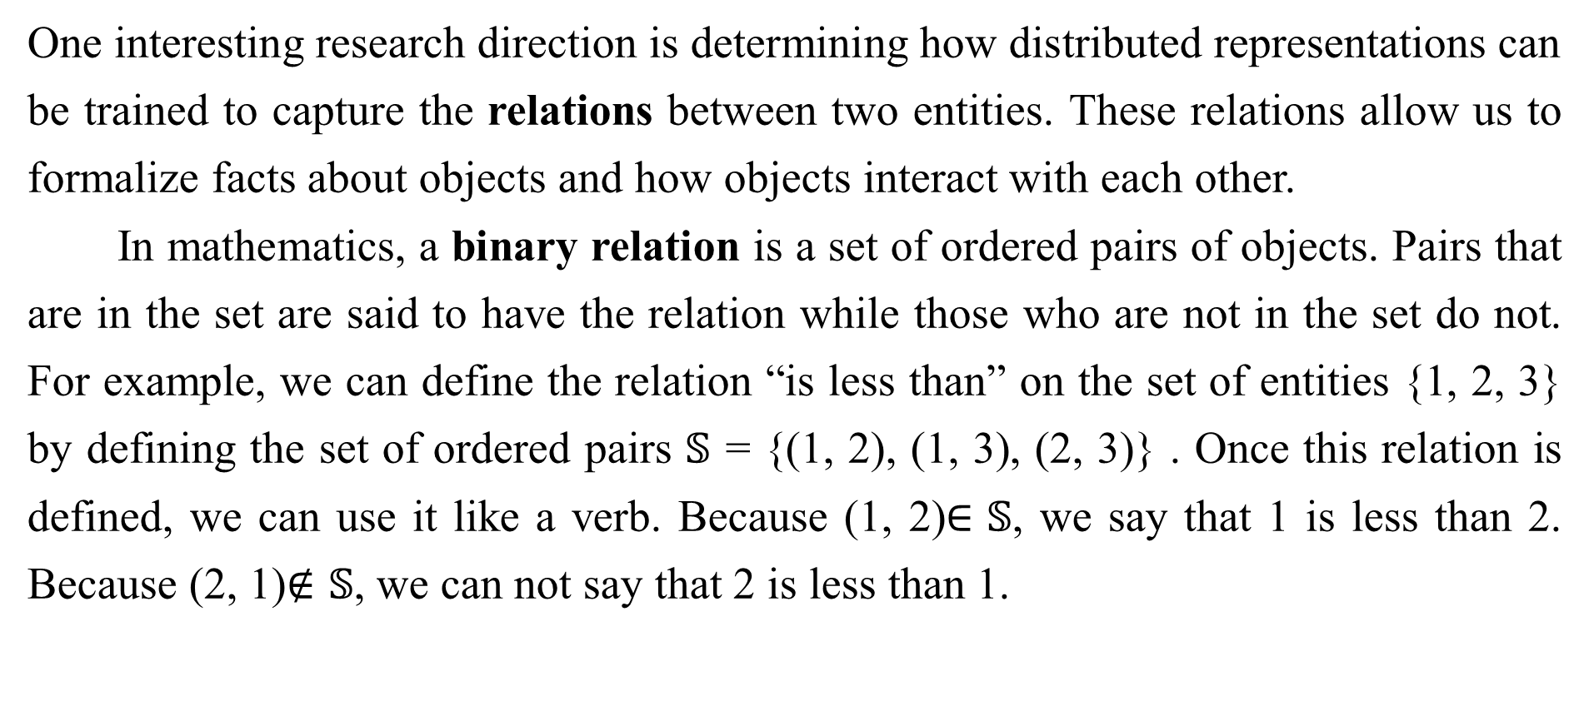
12.5.2.1 Knowledge, Relations and Question Answering
One interesting research direction is determining how distributed representations can be trained to capture the relations between two entities. These relations allow us to formalize facts about objects and how objects interact with each other.
In mathematics, a binary relation is a set of ordered pairs of objects. Pairs that are in the set are said to have the relation while those who are not in the set do not. For example, we can define the relation “is less than” on the set of entities {1, 2, 3} by defining the set of ordered pairs $𝕊$ = {(1, 2), (1, 3), (2, 3)} . Once this relation is defined, we can use it like a verb. Because (1, 2)$∈𝕊$, we say that 1 is less than 2. Because (2, 1)$∉𝕊$, we can not say that 2 is less than 1.

Slide 151
12.5.2.1 Knowledge, Relations and Question Answering
Of course, the entities that are related to one another need not be numbers. We could define a relation is_a_type_of containing tuples like (dog, mammal).
In the context of AI, we think of a relation as a sentence in a syntactically simple and highly structured language. The relation plays the role of a verb, while two arguments to the relation play the role of its subject and object. These sentences take the form of a triplet of tokens
(subject, verb, object) (12.21)
with values
(${entity}_{i}{,relation}_{j}, {entity}_{k}$) (12.22)

Slide 152
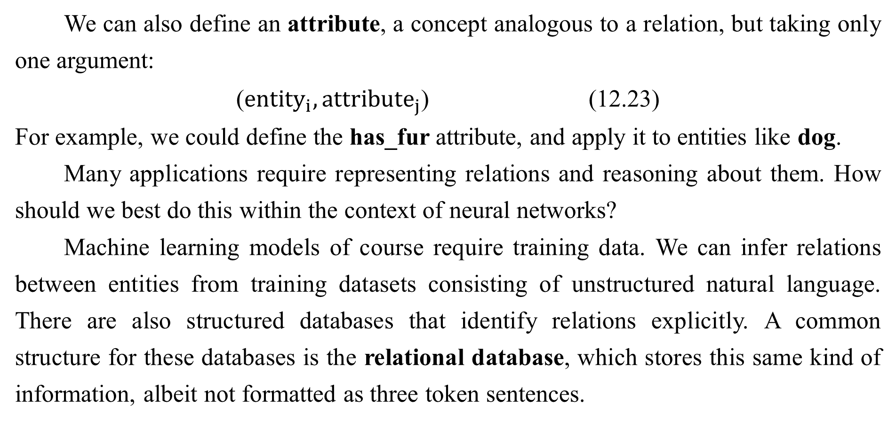
12.5.2.1 Knowledge, Relations and Question Answering
We can also define an attribute, a concept analogous to a relation, but taking only one argument:
(${entity}_{i}, {attribute}_{j}$) (12.23)
For example, we could define the has_fur attribute, and apply it to entities like dog.
Many applications require representing relations and reasoning about them. How should we best do this within the context of neural networks?
Machine learning models of course require training data. We can infer relations between entities from training datasets consisting of unstructured natural language. There are also structured databases that identify relations explicitly. A common structure for these databases is the relational database, which stores this same kind of information, albeit not formatted as three token sentences.

Slide 153
12.5.2.1 Knowledge, Relations and Question Answering
When a database is intended to convey commonsense knowledge about everyday life or expert knowledge about an application area to an artificial intelligence system, we call the database a knowledge base. Knowledge bases range from general ones like Freebase, OpenCyc, WordNet, or Wikibase, etc. to more specialized knowledge bases, like GeneOntology. Representations for entities and relations can be learned by considering each triplet in a knowledge base as a training example and maximizing a training objective that captures their joint distribution (Bordes et al., 2013a).
In addition to training data, we also need to define a model family to train. A common approach is to extend neural language models to model entities and relations.

Slide 154
12.5.2.1 Knowledge, Relations and Question Answering
Neural language models learn a vector that provides a distributed representation of each word. They also learn about interactions between words, such as which word is likely to come after a sequence of words, by learning functions of these vectors. We can extend this approach to entities and relations by learning an embedding vector for each relation. In fact, the parallel between modeling language and modeling knowledge encoded as relations is so close that researchers have trained representations of such entities by using both and knowledge bases natural language sentences (Bordes et al., 2011, 2012; Wang et al., 2014a) or combining data from multiple relational databases (Bordes et al., 2013b). Many possibilities exist for the particular parametrization associated with such a model.

Slide 155
12.5.2.1 Knowledge, Relations and Question Answering
Early work on learning about relations between entities (Paccanaro and Hinton, 2000) posited highly constrained parametric forms (“linear relational embeddings”), often using a different form of representation for the relation than for the entities.
For example, Paccanaro and Hinton(2000) and Bordes et al. (2011) used vectors for entities and matrices for relations, with the idea that a relation acts like an operator on entities. Alternatively, relations can be considered as any other entity (Bordes et al., 2012), allowing us to make statements about relations, but more flexibility is put in the machinery that combines them in order to model their joint distribution.
A practical short-term application of such models is link prediction: predicting missing arcs in the knowledge graph. This is a form of generalization to new facts, based on old facts.

Slide 156
12.5.2.1 Knowledge, Relations and Question Answering
Most of the knowledge bases that currently exist have been constructed through manual labor, which tends to leave many and probably the majority of true relations absent from the knowledge base. See Wang et al.(2014b), Lin et al.(2015) and Garcia-Duran et al.(2015) for examples of such an application.
Evaluating the performance of a model on a link prediction task is difficult because we have only a dataset of positive examples (facts that are known to be true). If the model proposes a fact that is not in the dataset, we are unsure whether the model has made a mistake or discovered a new, previously unknown fact. The metrics are thus somewhat imprecise and are based on testing how the model ranks a held-out of set of known true positive facts compared to other facts that are less likely to be true.

Slide 157
12.5.2.1 Knowledge, Relations and Question Answering
A common way to construct interesting examples that are probably negative (facts that are probably false) is to begin with a true fact and create corrupted versions of that fact, for example by replacing one entity in the relation with a different entity selected at random. The popular precision at 10% metric counts how many times the model ranks a “correct” fact among the top 10% of all corrupted versions of that fact.
Another application of knowledge bases and distributed representations for them is word-sense disambiguation (Navigli and Velardi, 2005; Bordes et al., 2012), which is the task of deciding which of the senses of a word is the appropriate one, in some context.

Slide 158
12.5.2.1 Knowledge, Relations and Question Answering
Eventually, knowledge of relations combined with a reasoning process and understanding of natural language could allow us to build a general question answering system. A general question answering system must be able to process input information and remember important facts, organized in a way that enables it to retrieve and reason about them later. This remains a difficult open problem which can only be solved in restricted “toy” environments. Currently, the best approach to remembering and retrieving specific declarative facts is to use an explicit memory mechanism, as described in Sec. . Memory networks were 10.12 first proposed to solve a toy question answering task (Weston et al., 2014). Kumar et al. (2015) have proposed an extension that uses GRU recurrent nets to read the input into the memory and to produce the answer given the contents of the memory.

Slide 159
12.5.2.1 Knowledge, Relations and Question Answering
Deep learning has been applied to many other applications besides the ones described here, and will surely be applied to even more after this writing. It would be impossible to describe anything remotely resembling a comprehensive coverage of such a topic. This survey provides a representative sample of what is possible as of this writing.

Slide 160
12.5.2.1 Knowledge, Relations and Question Answering
This concludes Part II, which has described modern practices involving deep networks, comprising all of the most successful methods. Generally speaking, these methods involve using the gradient of a cost function to find the parameters of a model that approximates some desired function. With enough training data, this approach is extremely powerful. We now turn to Part III, in which we step into the territory of research—methods that are designed to work with less training data or to perform a greater variety of tasks, where the challenges are more difficult and not as close to being solved as the situations we have described so far.

Slide 161
References
Ian Goodfellow, Yoshua Bengio and Aaron Courville. Deep Learning, MIT Press, 2016. http://www.deeplearningbook.org.
Guoqiang Zhong, Xiao Ling, Li-Na Wang: From shallow feature learning to deep learning: Benefits from the Width and Depth of Deep Architectures. Wiley Interdiscip. Rev. Data Min. Knowl. Discov. 9(1), 2019.
Guoqiang Zhong, Li-Na Wang, Xiao Ling, Junyu Dong: An Overview on Data Representation Learning: From Traditional Feature Learning to Recent Deep Learning. The Journal of Finance and Data Science 2(4): 265-278, 2016.

Slide 162
Thank you!
The ebooks, papers and materials referred for these slides are downloaded from the Internet. If any of them infringe your rights, please let’s know via email address gqzhong@ouc.edu.cn. If it is true, we will delete the corresponding content immediately. These slides can be freely utilized for teaching and research. For commercial usage, please let’s know first via the same email as above.

